Slide 1



UA – UVM
^{Cohort 1 - Spring 2024}
^{Student Orientation Session}

Slide 2

Arizona International
Agenda:
Introductions
Mel and Enid Zuckerman College of Public Health
University of Arizona: Overview and Resources
HED 102: Succeeding as a Global Wildcat
D2L Community
Questions
Notes:
Go through the agenda:
DO INITIAL INTROS OF THOSE PRESENT AND THOSE ONLINE (IF APPLICABLE)
You can say that we will take questions at the end of our presentation if needed. But, we do want to limit this time so that we can go forward with the individual program information from your deans, directors, and advisors.

Slide 3
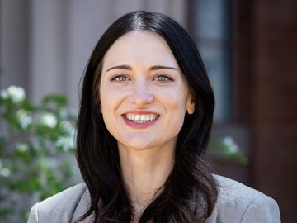
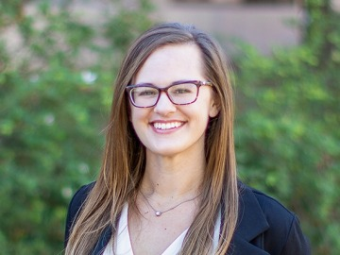
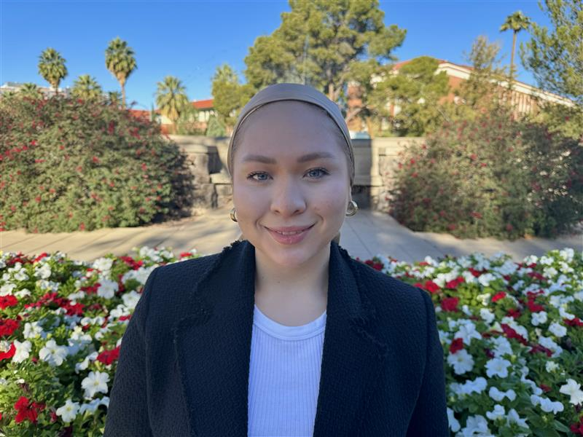
University of Arizona
Arizona International Team
Jennifer Koehmstedt
HED 102 Instructor
jrk1@arizona.edu
Katelyn Maragi
HED 102 Instructor
kmaragi@arizona.edu
Tianna Tom
Student Specialist
tiannatom@arizona.edu
Notes:
Our UA Lima students have a large administrative team behind them! That includes those of us in Arizona as much as those in Lima. Here we have listed your first point of contacts on the ground.
Our Location Manager, Laurie Loli, is currently on maternity but we wanted to make sure that you know who she is. Most of you probably already know her from your admission process AND I am sure you have RECEIVED many emails from her already. She will be returning to her position in June. We will keep you posted on her return.
In the meantime, Irene and Jorge will be your first point of contact and they will include the appropriate UA person as needed.

Slide 4

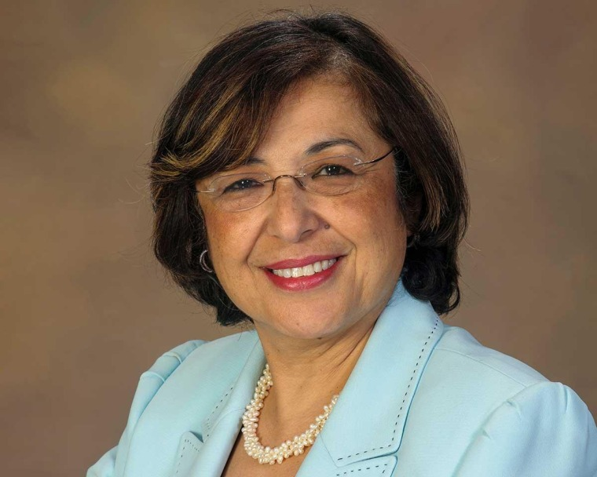
University of Arizona
College of Public Health
Iman A. Hakim, MD, PhD, MPH
Dean and Professor
Notes:
Our UA Lima students have a large administrative team behind them! That includes those of us in Arizona as much as those in Lima. Here we have listed your first point of contacts on the ground.
Our Location Manager, Laurie Loli, is currently on maternity but we wanted to make sure that you know who she is. Most of you probably already know her from your admission process AND I am sure you have RECEIVED many emails from her already. She will be returning to her position in June. We will keep you posted on her return.
In the meantime, Irene and Jorge will be your first point of contact and they will include the appropriate UA person as needed.

Slide 5
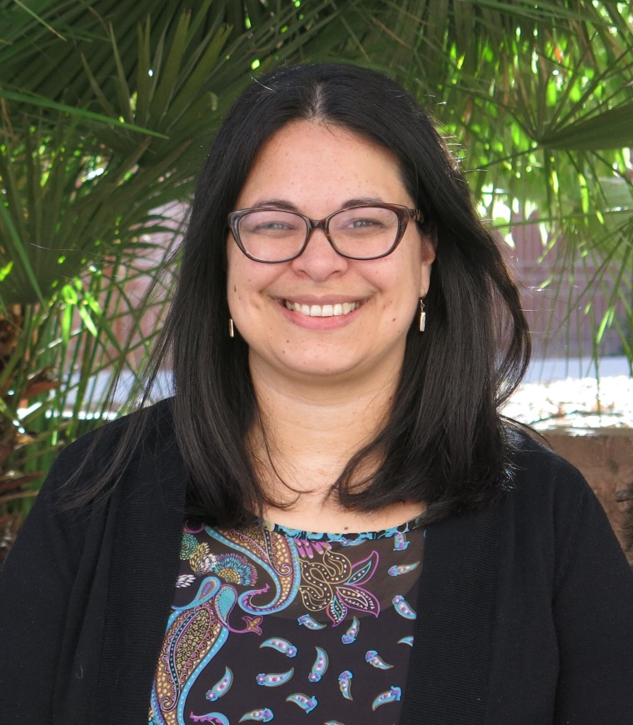
University of Arizona
College of Public Health
Gabriela Valdez PhD
Director, Global Health Program, and Director, MEZCOPH Global Education
Notes:
Our UA Lima students have a large administrative team behind them! That includes those of us in Arizona as much as those in Lima. Here we have listed your first point of contacts on the ground.
Our Location Manager, Laurie Loli, is currently on maternity but we wanted to make sure that you know who she is. Most of you probably already know her from your admission process AND I am sure you have RECEIVED many emails from her already. She will be returning to her position in June. We will keep you posted on her return.
In the meantime, Irene and Jorge will be your first point of contact and they will include the appropriate UA person as needed.

Slide 6
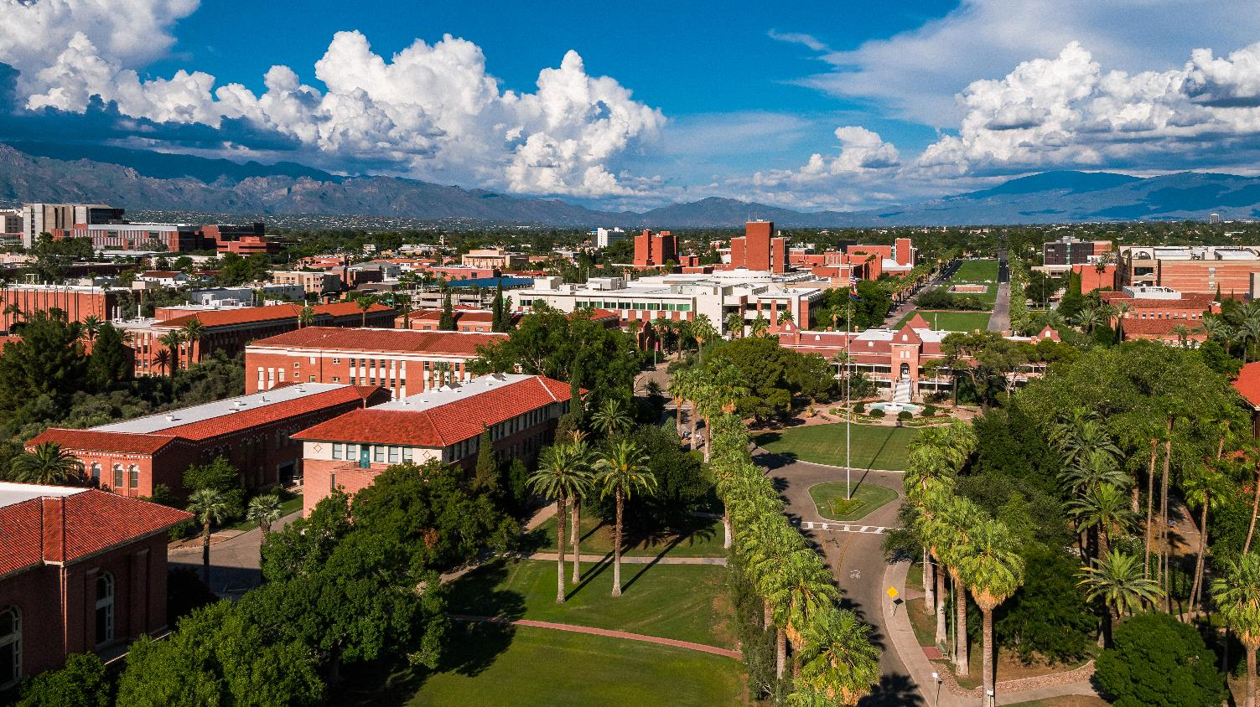

Bachelor of Science in Public Health

Slide 7
UVM Medicine Degree
Dual Degree Timeline
UA BS Public Health
Notes:
Our UA Lima students have a large administrative team behind them! That includes those of us in Arizona as much as those in Lima. Here we have listed your first point of contacts on the ground.
Our Location Manager, Laurie Loli, is currently on maternity but we wanted to make sure that you know who she is. Most of you probably already know her from your admission process AND I am sure you have RECEIVED many emails from her already. She will be returning to her position in June. We will keep you posted on her return.
In the meantime, Irene and Jorge will be your first point of contact and they will include the appropriate UA person as needed.

Slide 8
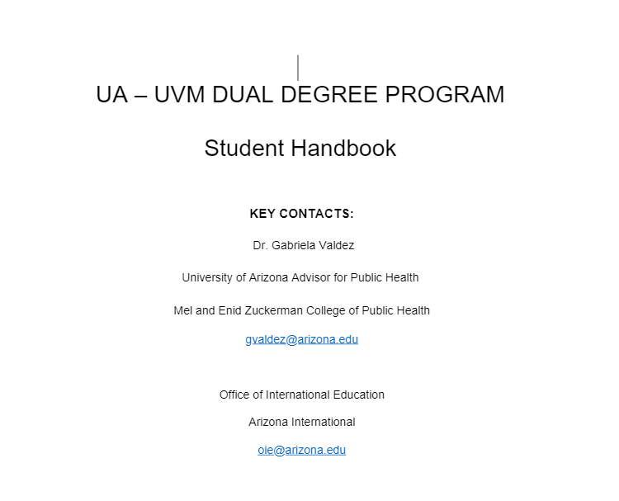
Student Handbook
(Will be emailed to you)

Slide 9

HED 102A/B: Succeeding as a Global Wildcat
HED 102 will be your first course taken in the dual degree program with the University of Arizona. This course is designed to introduce you to UArizona, its policies, resources and the learning platform D2L: Desire to Learn.
Notes:
You will receive a conversion chart from your UPC advisor – showing the total grade points and the UPC grade equivalent. NUMERIC 1-20
KEEP IN MIND - UA grades are letter grades. Official grades are posted in UAccess. This is different from seeing your grades in D2L. Letter grades have the equivalent numeric value which calculates your GPA.
Your UA GPA will ONLY include your UA course grades. UPC courses that are transferred in count as PASS grades only. No numeric value.

Slide 10
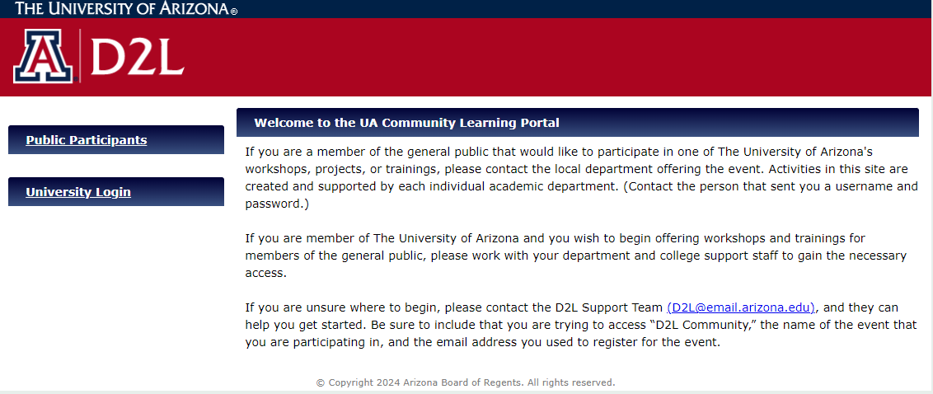
D2L (Desire to Learn) Community
community.d2l.arizona.edu
Notes:
Follow slide and walk through the highlighted steps.

Slide 11
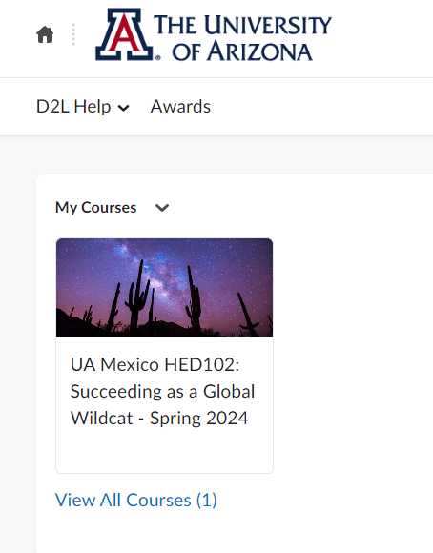
HED 102A/B: Next Steps
Remember:
You will be emailed login instructions from D2L Community.
Class dates:
  HED 102A: March 11, 2024 – May 1, 2024
  HED 102B: May 13, 2024 – June 28, 2024
Assignments are usually due every week on Sunday (check syllabus for schedule of assignments).
Notes:
Follow the slide and walk through the steps:
Finding your courses in the current semester.
Point out the semester terminology. Exam 2024-01 = Spring 2024

Slide 12

QUESTIONS?
Notes:
Take some questions – not to many – watch the time - and then hand it over to the program admins. Know the program you are working with so you can choose the next introductory slide:
Justin – working with SBS – please at this point give instruction to have COMM GROUP move to other room.

