Slide 1
SIE Degree Requirements and Graduation Steps

Slide 2
Your Support System at UArizona
Graduate Student Academic Services, Arizona International, and Systems & Industrial Engineering:
  Review and Approves your GradPath Forms
  Process Transfer Credit Evaluation Forms
  Ensure the Graduate Departments and students are in compliance with policy
  Review and audits your degree
  Award your degree after final review
  Provide Certificate of Completion

Slide 3
Graduation Flow Chart
1. Finish your UArizona + UPC courses
2. Send your UPC official transcripts to UArizona
3. GradPath > FIRST - Submit your Transfer Credit Evaluation form listing UPC courses
4. GradPath > Complete remaining GradPath forms and SIE MS Exit Survey
5. Graduate!
Notes:
Cindy

Slide 4
Industrial Engineering (MS) – 33 units
UArizona SIE Courses
UPC Courses
  9 UA SIE courses (27 Units Total)
    SIE 514: Law for Engineers & Scientists (3)
    SIE 515: Technical Sales & Marketing (3)
    SIE 522: Engineering Decision Making Under Uncertainty (3)
    SIE 530: Engineering Statistics (3)
    SIE 540: Survey of Optimization (3)
    SIE 557: Project Management (3)
    SIE 565: Supply Chain Management (3) OR SIE 508: Reliability Engineering (3) **(Study Arizona)**
    SIE 567: Financial Modeling for Innovation (3)
    SIE 554A: Systems Engineering Process (3)
2 UPC courses (6 Units Minimum)
  For Industrial students at UPC:
    IN218 Environmental Engineering & Mgmt (4)
    IN196 Technology & Industrial Automation (3)
  For Systems students at UPC:
    SI391 or SI639: Professional Development Workshop (5)
    SI429 or SI655: Database Management (3)
Notes:
Cindy

Slide 5
Am I eligible to graduate ?
Cumulative UArizona GPA
Cumulative GPA is a 3.00
All UArizona SIE courses are at least "C" grade or higher
Enrollment
Enrolled in at least 1.00 graduate credit hour in graduation term at UArizona
GradPath
Complete all GradPath forms, which we will go over now!
All UPC courses are "B" grade or higher after conversion
Notes:
Cindy

Slide 6
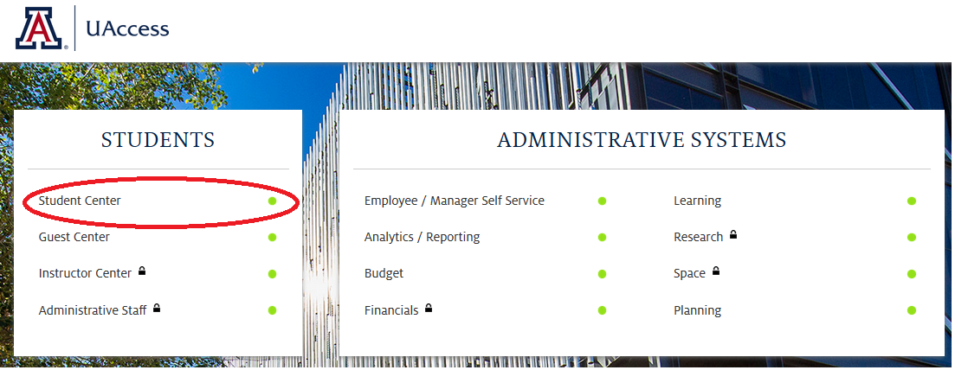
How do I navigate GradPath?
uaccess.arizona.edu
Click on ‘Student Center’
Log in with your UArizona NetID and Password
  NOT your 8 digit student ID number
Notes:
Lupita

Slide 7
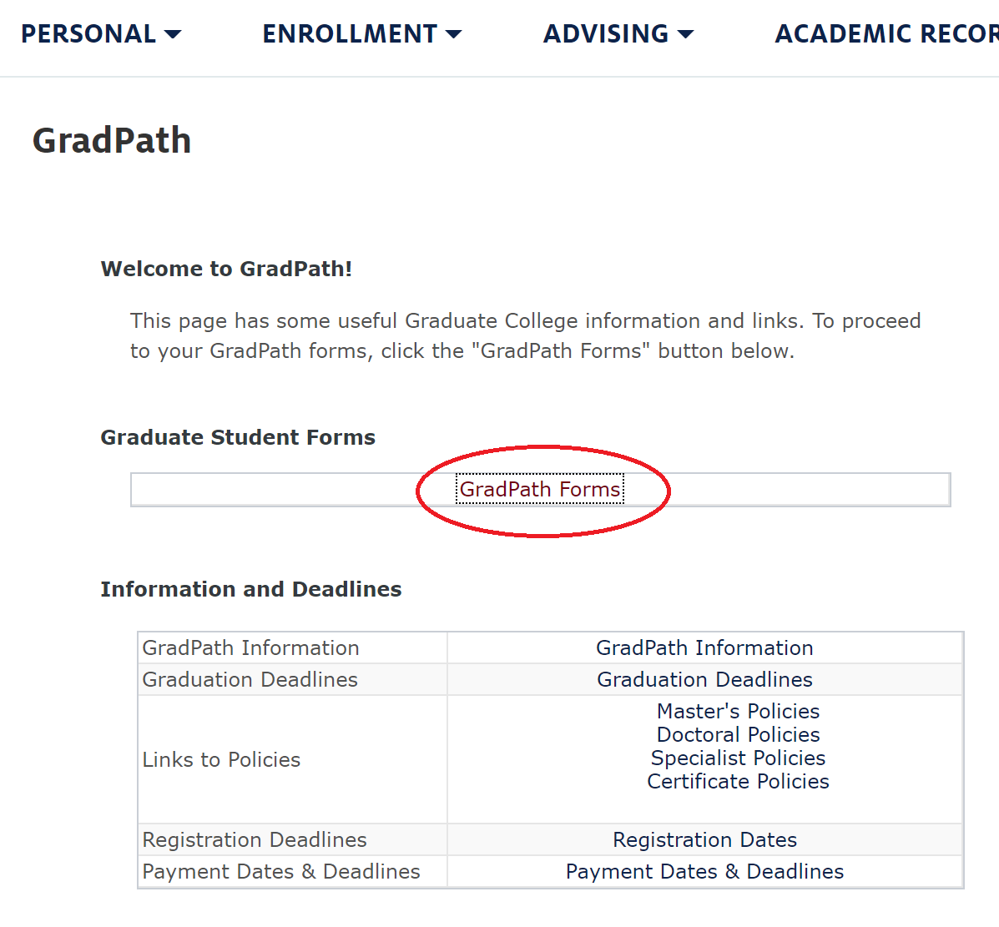
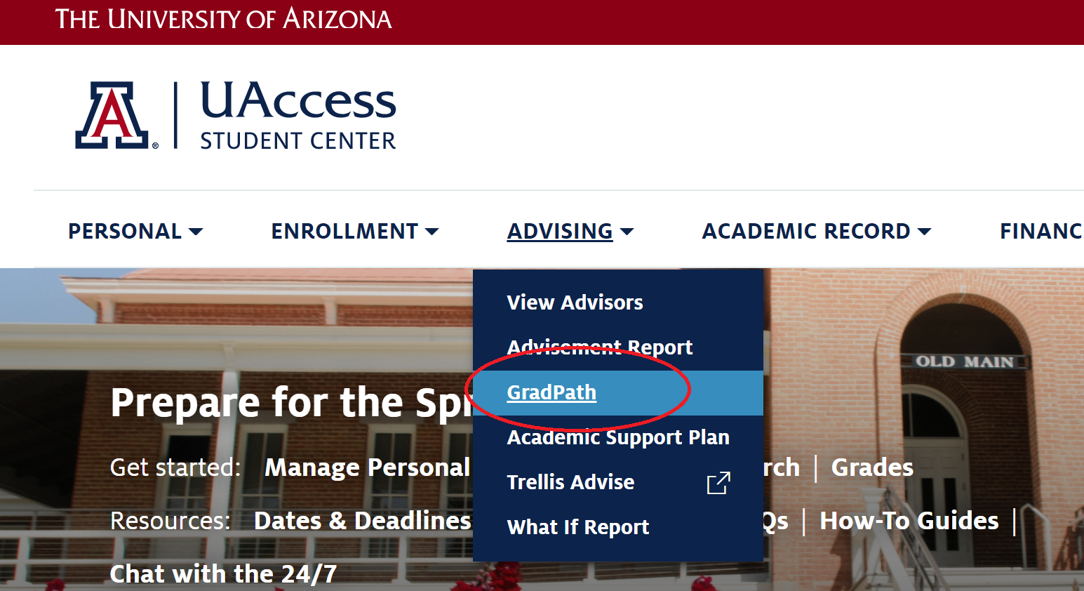
How do I navigate GradPath?
Notes:
Lupita

Slide 8
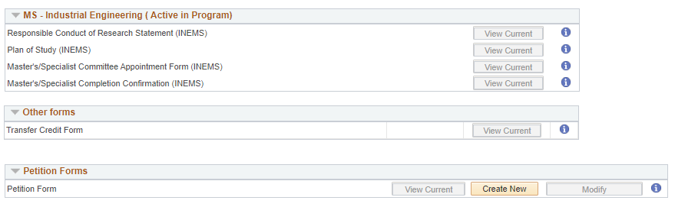
GradPath: Home Page
Notes:
Lupita

Slide 9
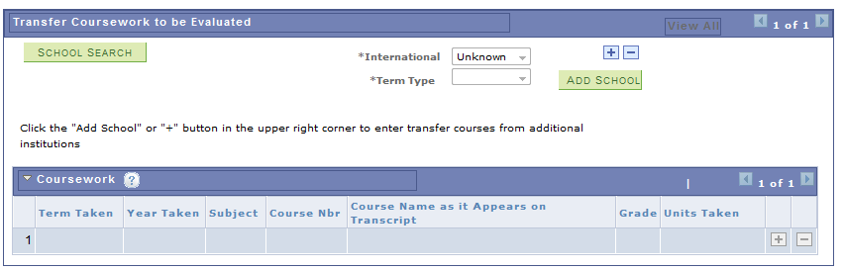
GradPath: Transfer Credit Evaluation Form
Select 'School Search' and search for UPC
Next to 'International,' select 'Yes'
Next to 'Term Type,' select 'Semester'
Add 2 approved UPC courses
  Term taken (I.e.: Fall)
  Year (I.e.: 2022)
  Subject – (I.e.: IN)
  Course number (I.e.: 160)
  Course name as it appears on transcript (I.e.: Layout Planning)
  Grade earned as it appears on transcript
  Units earned as they appear on transcript
Do not convert the grades and units
Graduate College will review
"Spring" at UA = Term 1 at UPC and runs from March to July
"Fall" at UA = Term 2 at UPC and runs from August to December
"Winter" at UA = Summer session at UPC and runs from January to February
Notes:
Lupita

Slide 10
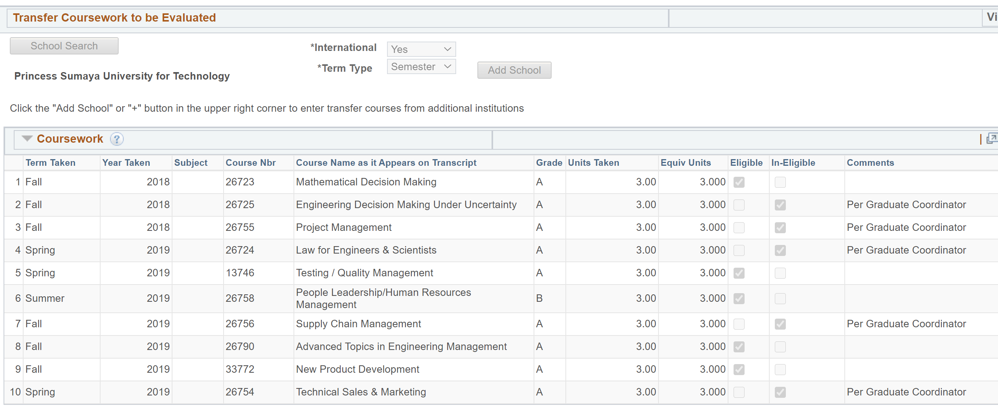
GradPath: Transfer Credit Evaluation Form
1. School Search: Universidad Peruana de Ciencias Aplicadas
2. International: Yes
3. Term Type: Semester
This is where the 2 UPC transfer courses are added to be used on UArizona INE MS Plan of Study
Universidad Peruana de Ciencias Aplicadas
Notice that grades and units were reviewed by Graduate College
Notes:
Lupita

Slide 11
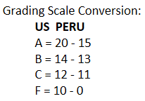
GradPath: Transfer Credit Evaluation Form
Remember, only grades equivalent to a B or higher will transfer into UArizona.
Anything lower than a B equivalent will need to be retaken at UPC before it will transfer in, and thus, before you can graduate from UArizona.
Again, do not convert the grades on your Transfer Credit Evaluation Form yourself! GSAS will do this for you.
Notes:
Lupita/Megan

Slide 12
MS: GradPath
Student forms must be submitted in order. Each form has a routing process.
SIE Faculty Academic Advisor (Professor Afrooz Jalilzadeh)
You are responsible for 3 of the 4 forms:
1. Responsible Conduct of Research
2. Plan of Study
3. Master’s/Specialist Committee Appointment Form
4. Master’s/Specialist Completion Report
** You do not do this form. SIE will submit this to the Graduate College to confirm completion of department degree requirements.

Slide 13
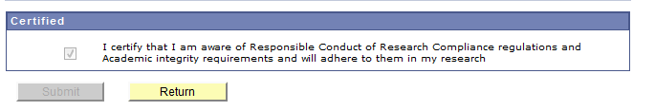
MS: GradPath
Responsible Conduct of Research
  This is the first GradPath form for all students
Until you complete this form, you will not have access to any of the other forms.
This form does not require any approval, so you will have access to the other forms immediately.

Slide 14
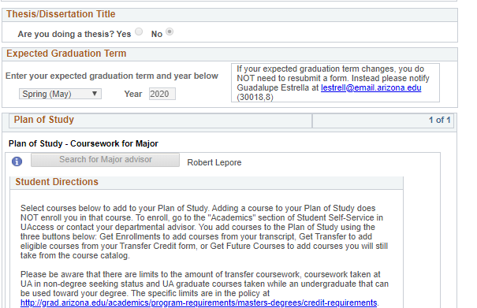

MS: GradPath - Plan of Study
On your Plan of Study:
Indicate that you are NOT doing a thesis.
Enter your Expected Graduation Term (EGT)
  If your EGT is different than what you see, you can change it here. Once Plan of Study is approved by the Graduate College, it will update the system
Select your Faculty Advisor (Searching via first and last name is easiest): Afrooz Jalilzadeh

Slide 15
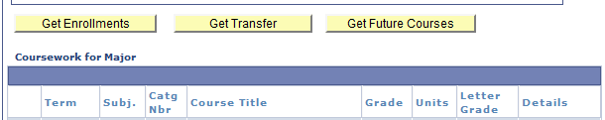
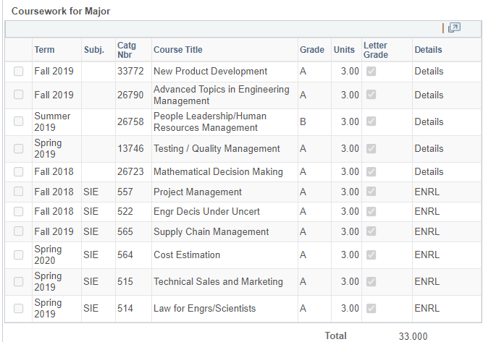
MS: GradPath - Plan of Study
List the courses needed to meet your degree requirements:
You can select from:
Get Enrollments – UA courses you have already taken
Get Future Courses - Do not use this
Get Transfer – Courses that have been approved through the Transfer Credit Evaluation form
(Transfer Credit Evaluation form must be submitted and courses must be verified before completing the Plan of Study form)
Notes:
Lupita

Slide 16
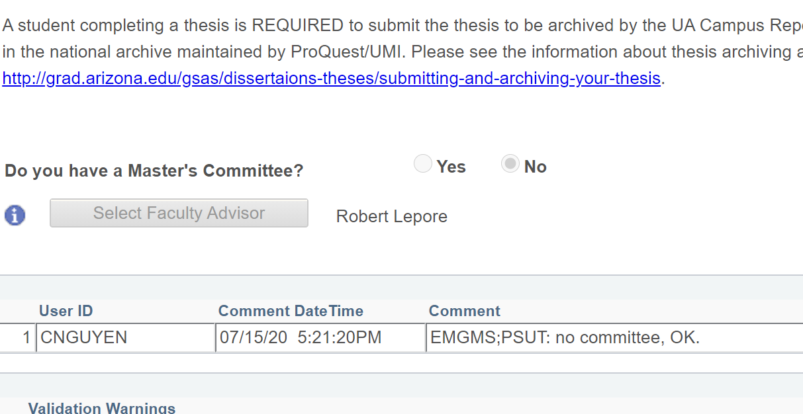
MS: GradPath – Master’s Committee Form
It will ask if you have a Master's/Specialist committee.
  Select "No"
This will auto-populate your faculty academic advisor's name.
Notes:
Lupita

Slide 17
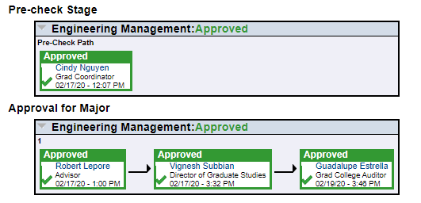
MS: GradPath - Routing
After you submit a form you can scroll to the bottom of the form and see who has yet to make a decision and when they received the form
When someone approves your form, it will route automatically to the next reviewer
Notes:
Lupita

Slide 18
Frequently Asked Questions: GradPath
  My Expected Graduation Term (EGT) says “Spring 2022” (or the wrong term) but I am graduating Fall 2022 (or a different term)? What do I do? Indicate your actual EGT on your plan of study. Once approved by the Graduate College, it will update in the system.
  My classes end after the Graduate College program completion deadline for my expected graduation term, will that negatively impact my diploma? No, your diploma will still list the conferral date of your expected graduation term.
  How long does it take for me to receive my diploma once my degree is posted? ~ 4-6 weeks. We will mail one batch to UPC to make it easier.

Slide 19
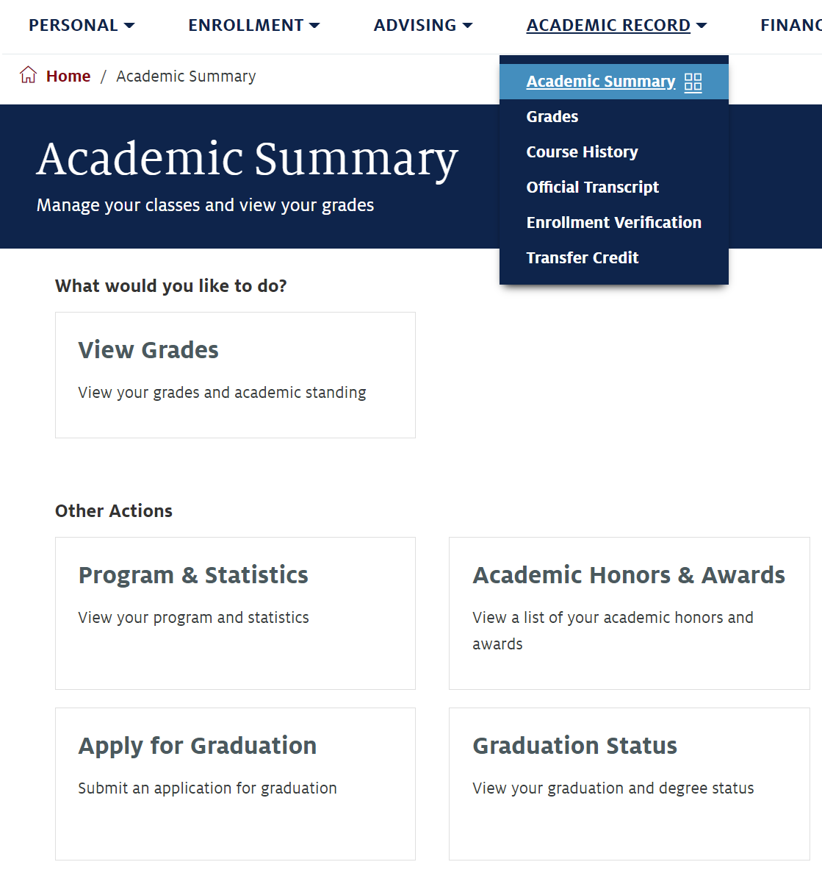
Next Steps: Receiving your UArizona Diploma
It usually takes 10-14 business days for your degree to post after all required GradPath forms have been completed.
You can confirm your degree has been posted in the Academic Summary section of your Student Center (studentcenter.arizona.edu).
Your physical diploma will be shipped to UPC about a month or so after your degree has been posted.

Slide 20
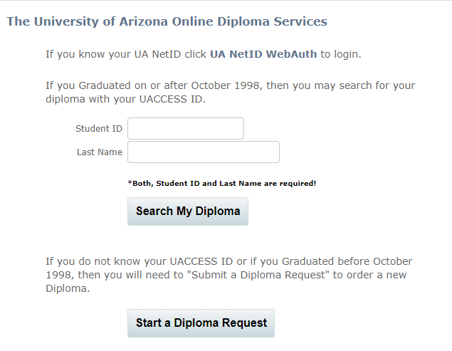
Next Steps: Receiving your UArizona Diploma
If you need proof of degree completion quickly for a job opportunity or further education, you can order an eDiploma 10 days after your degree has been posted.
Your eDiploma is a signed and certified PDF of your original paper diploma used for easy diploma verification purposes. You will receive your eDiploma within 60 seconds of ordering.
There is a one-time $20 USD charge. You can then forward your eDiploma as often as you need.
For document security, the eDiploma cannot be printed.
Link to order eDiploma AND to check status of Diploma: https://www.michaelsutter.com/arizona
  Login using your NETID and PASSWORD. Do not log in using the other options!

Slide 21
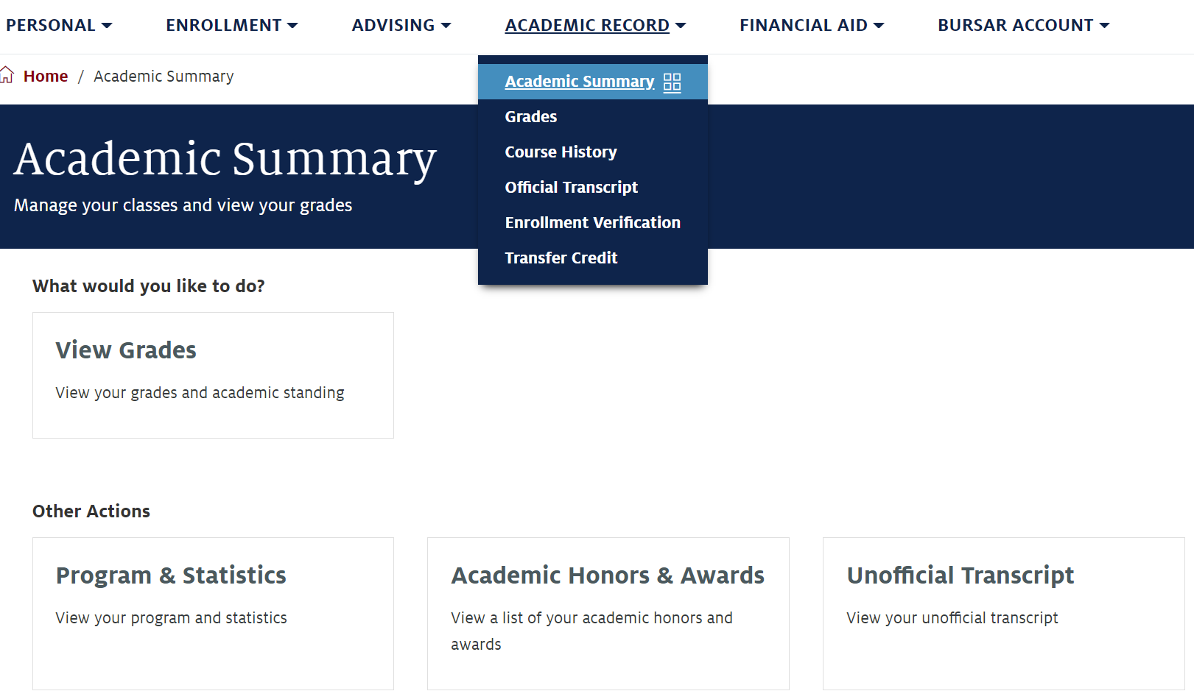
Next Steps: Ordering UArizona Transcripts
You can order unofficial UArizona transcripts at any time, free of charge, in your UAccess Student Center (studentcenter.arizona.edu).

Slide 22
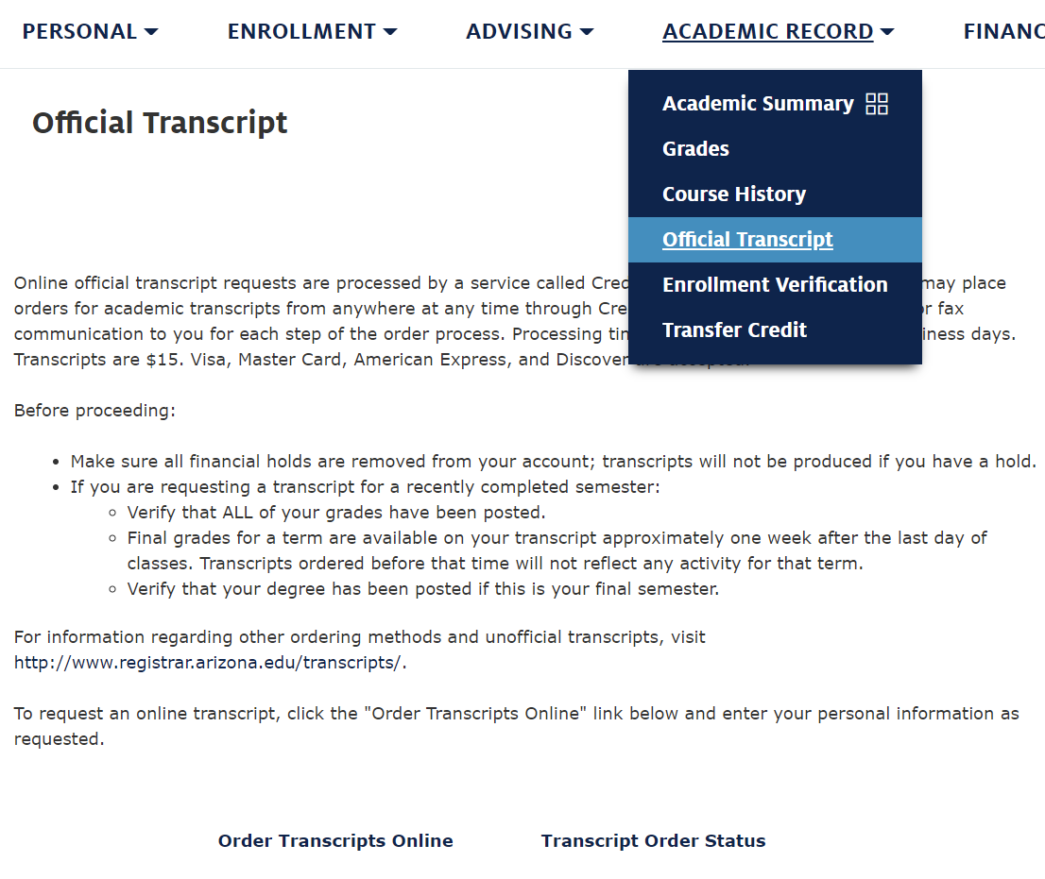
Next Steps: Ordering UArizona Transcripts
You can also order official UArizona transcripts in your UAccess Student Center (studentcenter.arizona.edu).
You can order physical or digital copies. Price depends on your format and shipping choice, but you must use a credit card for payment.
WE HIGHLY RECOMMEND selecting International Federal Express shipping so you can receive a tracking number and monitor the shipping history as your package travels to you internationally.
Transcripts have gotten lost in the mail, and the Registrar’s Office is not accountable for lost mail, nor will they give you a refund.

Slide 23
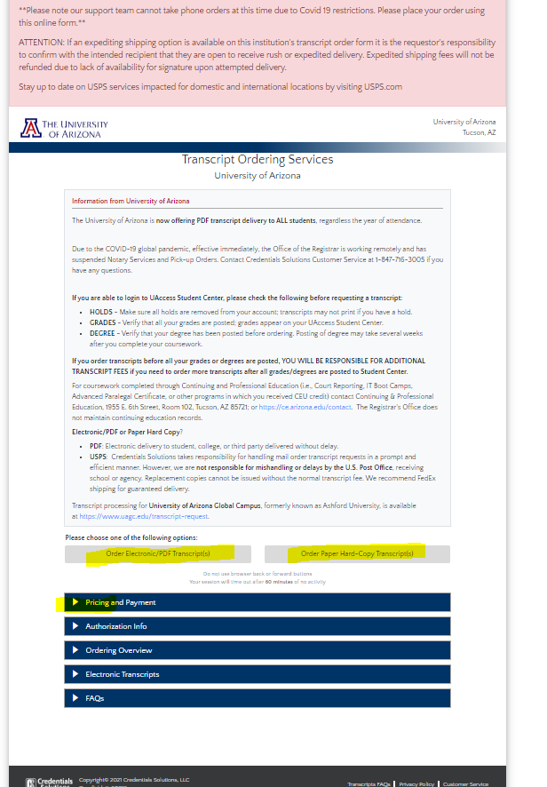
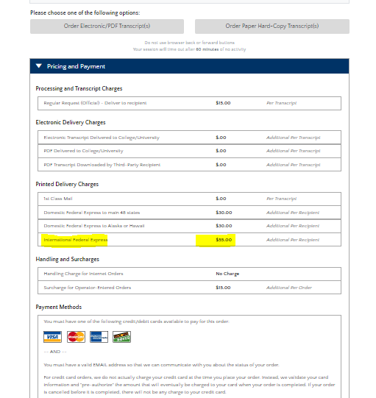
Next Steps: Ordering UArizona Transcripts
You will be routed to a separate screen via Credentials Solutions.
Under "Pricing and Payment", various options of delivery are available here.
If you are also looking to deliver to a U.S location, federal express domestic options are also available.

Slide 24
Next Steps: Attending Graduation
We would love to see you all in Tucson for graduation!
Details regarding the ceremony will be sent to you as soon as we are officially notified of what events will be occurring and when they will occur.
Generally, Fall graduates will have a ceremony in December hosted by the College of Engineering, and Spring & Summer graduates will have a ceremony in May hosted by the SIE Department.
Notes:
Cindy

Slide 25
Next Steps: Attending Graduation
Arizona International can assist with the immigration process by providing an official letter of invitation that you can submit with your visa application (you will most likely need a B2 tourist visa – this program does not qualify you for an F1 student visa!).
You will be sent a survey to request this letter soon if you have not already received it.
This letter of invitation is the only assistance UArizona can provide with your trip to Tucson. You will be fully responsible for planning and paying for your travels to Tucson, like any other vacation you might take.
Notes:
Cindy

Slide 26
Contact Us!
Department of Systems and Industrial Engineering:
gradadvisor@sie.arizona.edu
Arizona International Office:
microcampus@arizona.edu
Graduate College Degree Counselor:
meganmcnulty@arizona.edu

