Slide 1


ORIENTATION
Fall 2024
Notes:
Introduction: Amanda
Welcome Everybody! Today's webinar is sponsored by the University of Arizona
​​
I hope you are all doing well and staying safe and healthy. We would like to welcome all of you and thank you for joining us today to our University of Arizona orientation and live info session. We admire and congratulate you on wanting to further your education. ​​
​​
My name is Greg. We are going to first talk about a few rules for the webinar. During the live session, all participants are to remain muted so we can best hear our speakers. ​​
​​
Today we will be discussing what to expect as a University of Arizona Wildcat
​​
​​

Slide 2

Next Steps After Admission
About the steps you must complete after being admitted to the UA.
Notes:
Thuy
Now, let’s go through an overview of the basic steps you need to take once you have become an UofA student.
Our first speaker will be Thuy
Welcome again Thuy!

Slide 3
NETID & PASSWORD
You will use one NetID & password to access all UA resources:
UA email (Catmail)
Online Learning Platform D2L
Student Portal: UAccess
UA Library
If you have not created your NetID and Password, please do so AS SOON AS POSSIBLE!
Notes:
Thuy
The first thing you will need to do is to create an NetID and Password.
All of communication relate to your study with UofA will be sent to your UA email. Therefore, if you have not created your NetID and Password, please do so as soon as possible. Otherwise, you will miss out important information.

Slide 4
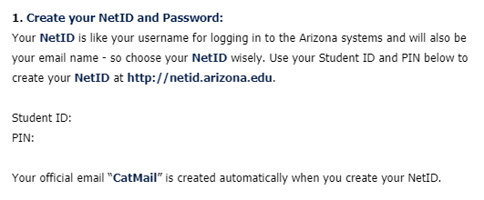
NETID & PASSWORD
To create your NetID & Password, look for the email title “Your Name, Congratulations - You Are Admitted!” Scroll down to find instruction to create your NetID & Password
Take note of your UA Student ID Number because you will need it throughout your career as a UA student.
Notes:
Thuy

Slide 5
NETID & PASSWORD
If you cannot find this instructions email with Student ID and PIN, please contact
UA Jakarta: Miss Tri (tritjahjono@arizona.edu)
We will request to resend the information to you
Notes:
Thuy

Slide 6
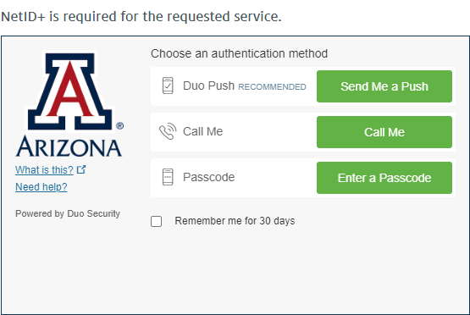
NETID+
NetID+ is the second layer of authorization and security.
When you login the first time after creating your NetID, you will be prompted to sign up for NetID+. Please go ahead and follow the prompted instructions.
Notes:
Thuy
After creating your NetID and Password, please go ahead and login to your UA email. When you login, you will be prompted to sign up for NetID+
There will be 3 options for NetID+. We highly recommend you to chose the DuoMobile option because this is the most convenient option and it will affect you if you change your phone number later.

Slide 7
NETID+
You can also review a detailed instruction for NetID+ in this link: https://it.arizona.edu/service/netid-plus
Select the "Support, How-To’s & Info" tab
Notes:
Thuy
If you have any troubles registering for NetID+, you can review a detailed instruction in this link. Remember to select the Support tab

Slide 8
CATMAIL
catmail.arizona.edu
All UA related emails will be sent to your CatMail.
It is VERY IMPORTANT to check your Catmail everyday and set up Catmail on your phone for new email notifications.
Notes:
Thuy

Slide 9
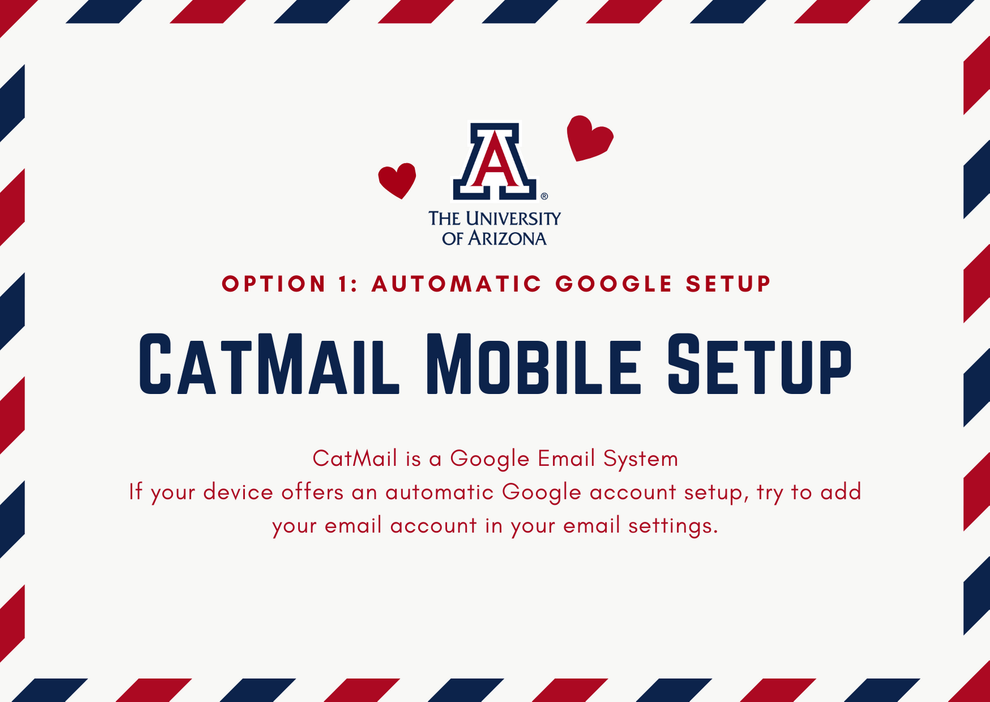
Notes:
Thuy
Make sure to set up your Catmail on your phone, so you receive notifications when there are new emails.
Catmail is Google Email System. To do so, install Gmail application on your phone.

Slide 10
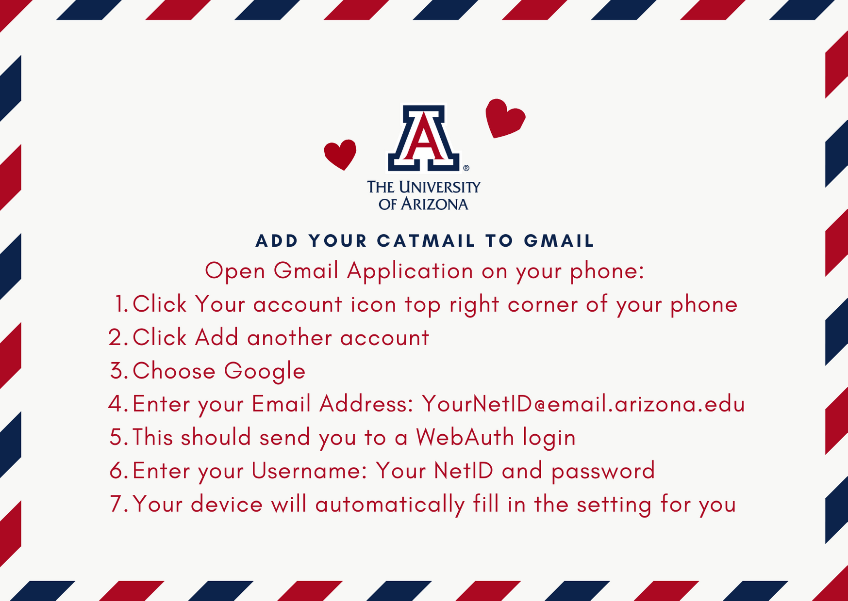

Slide 11
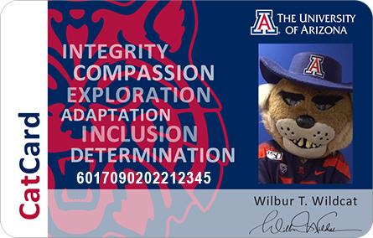
CATCARD
The CatCard is the official University of Arizona identification card. Stay tuned for CatCard info!
Notes:
Thuy
At the University of Arizona, we want to ensure to facilitate a sense of community, both with the UA main campus and globally.
The CatCard we provide is an official University of Arizona ID. The CatCard is identical to that which a student at our main campus would receive as well.
This ID may be used for discounts for students who study at our main campus in Tucson and abroad at destinations that ask if you could provide a school ID for a discount. (I know students who have used the school ids to receive discounts at museums and other locations)

Slide 12
What if I cannot login to any UA websites?
Option A: You need to contact the IT Department of your home institution immediately
Option B: If you cannot log in means you are not enrolled in UA classes. No need to worry.
Option C: Your password might be expired. You need to contact the Location Manager at UA Jakarta or the UA 24/7 IT Support service to reset password.
Notes:
Thuy
At the University of Arizona, we want to ensure to facilitate a sense of community, both with the UA main campus and globally.
The CatCard we provide is an official University of Arizona ID. The CatCard is identical to that which a student at our main campus would receive as well.
This ID may be used for discounts for students who study at our main campus in Tucson and abroad at destinations that ask if you could provide a school ID for a discount. (I know students who have used the school ids to receive discounts at museums and other locations)

Slide 13
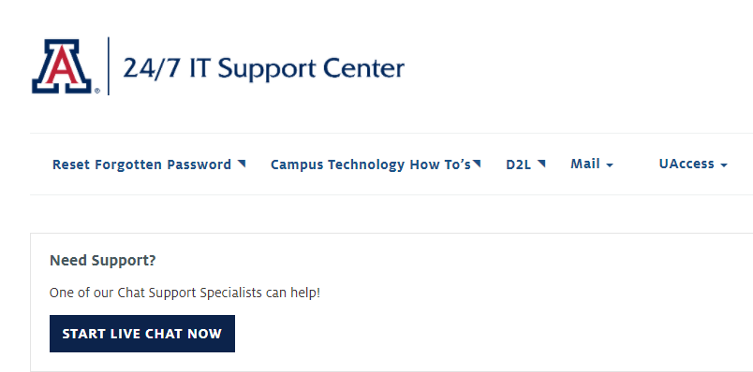
24/7 IT Support Center
The 24/7 IT Support Center is available 24 hours a day, 7 days a week to help UA students with campus systems and applications.
Go to: https://support.arizona.edu/ and click START LIVE CHAT NOW
du/
Notes:
Thuy
At the University of Arizona, we want to ensure to facilitate a sense of community, both with the UA main campus and globally.
The CatCard we provide is an official University of Arizona ID. The CatCard is identical to that which a student at our main campus would receive as well.
This ID may be used for discounts for students who study at our main campus in Tucson and abroad at destinations that ask if you could provide a school ID for a discount. (I know students who have used the school ids to receive discounts at museums and other locations)

Slide 14
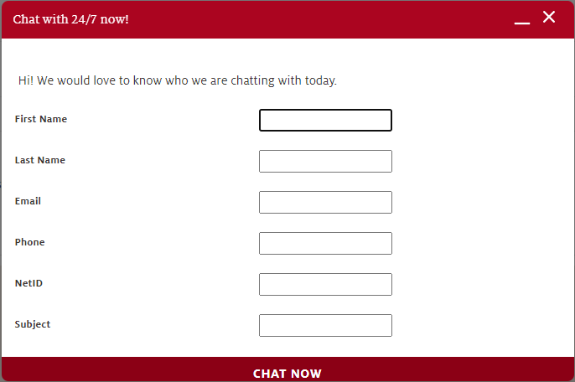
24/7 IT Support Center
A chat box will pop up. Fill out your name, UA email address, NetID, and what you want IT to help you with. Then click CHAT NOW.
A chat window will pop up with an IT representative assigned to help you. The IT representative will ask you some questions to ensure your identity before helping you with the technical problem
A chat du/
Notes:
Thuy
At the University of Arizona, we want to ensure to facilitate a sense of community, both with the UA main campus and globally.
The CatCard we provide is an official University of Arizona ID. The CatCard is identical to that which a student at our main campus would receive as well.
This ID may be used for discounts for students who study at our main campus in Tucson and abroad at destinations that ask if you could provide a school ID for a discount. (I know students who have used the school ids to receive discounts at museums and other locations)

Slide 15
24/7 IT Support Center
Besides helping you troubleshoot login to Catmail, D2L, and UAccess Student Center, the UITS Support also:
Troubleshooting problems on student, faculty, or staff computers
Installing operating systems and software. Software licenses must be provided by the customer
Removing spyware and viruses
Removing unwanted software
Installing wired or wireless networking cards
Troubleshooting network problems
Taking reports of problems with the UA wired or wireless network
Notes:
Thuy
- Note: The 24/7 IT Support Center technical consultants are available to assist with UA applications and services or to help you with your personally owned computer or device. The center can also provide information such as the location of campus computer labs, the availability of on campus training, and information about obtaining off campus assistance. This includes support with your Net ID, password, D2L, as well as support with any other UA related systems issues or inquires.
- If for some reason you believe your issue was not resolved that is when you will contact your Location Manager or advisor to help direct your inquiry to the appropriate resources.
- The staff are very on top of the inquiries they receive and typically answer a “chat request” within 2 minutes.
The steps to utilizing UITS 24/7 UITS support system are the following:
Available UITS 24/7 Support Services
Supporting applications such as CatMail, UAConnect, D2L, UAccess, and NetID
Troubleshooting problems on student, faculty, or staff computers
Installing operating systems and software. Software licenses must be provided by the customer.
Removing spyware and viruses
Removing unwanted software
Installing wired or wireless networking cards
Troubleshooting network problems
Taking reports of problems with the UA wired or wireless network
The center will run diagnostics and perform basic fixes at no cost for members of the UA campus community. If your technical consultant determines that your system needs a computer repair service, the UA BookStore's Computer Service Center has certified repair technicians on staff.
Thuy
You may want to take a screenshot of this on your phone.
These are the steps by which you will utilize to gain support from our 24/7 UITS system
I get systems and IT related questions everyday. My first course of action is to direct students utilizing these steps
95% of the time the students are able to gain all of their answers by themselves
In the rare case that a student does not reach a solution They let me know and I either meet with them on Zoom or I work to identify the appropriate resources at UA.
Either way we always reach a solution and start by taking these steps:
The steps to utilizing UITS 24/7 UITS support system are the following:
Access the following link: https://support.arizona.edu/
Under Issue Submission you want to do the following:
Choose 24/7 tech support
Enter your name
Enter your issue
A chat box will pop up and there will be a message that says: “This application allows a support representative to chat with you. Accept this message.”
You will be assigned a representative. A message will pop up where you accept theFull Terms & Conditions
Then you start your chat conversation.
Please reach out to the uaphnompenh or uajakarta emails if you would need to access this information again.
At UA we want to provide the necessary support while empowering students to help resolve issues and this is a great tool to accomplish just that.

Slide 16
Program Overview
Degree requirements and graduation timeline.
Notes:
Katelyn
Hello everyone! In this section I will go over all of the requirements you will need to meet to earn a degree from the University of Arizona and I’ll also talk a little bit about how graduation works.

Slide 17

DUAL DEGREE PROGRAMS
The University of Arizona has partnered with several institutions to offer a broad range of dual degree programs.
Notes:
Katelyn
The University of Arizona has partnered with AUPP because of the quality of its facilities, faculty, staff, and STUDENTS! You can earn at UA degree in 4 years entirely in Cambodia, at the same time that you earn an AUPP degree. You earn the exact same degree that you would get if you studied in the United States.
******The University of Arizona has partnered with several institutions to offer a broad range of dual degree programs. We have locations in Cambodia and Indonesia of course, but also in Mauritius, China, Peru, Jordan, the UAE, and Iraq so you are part of a very extensive and diverse educational network so you have classmates all across the world.

Slide 18
WHAT ARE DUAL DEGREE PROGRAMS?
 | SAMPOERNA UNIVERSITY | UNIVERSITY OF ARIZONA
Separate Admissions | To study with UA, student must enroll first at partner institution | Students apply to UA at the end of their 1st year (beginning of 2nd year at partner institution)
Transfer Credits | Courses taken with UA will transfer to student’s home degree | Courses taken with partner will transfer to student’s UA degree
Program Lengths | If students follow strictly the courses that are pre-assigned each semester, students will graduate within 4 years.
Two Graduation Ceremonies | Students join graduation with their local schoolmates at the end of May | Students are invited to Arizona to join UA graduation ceremony
Two Diplomas | Students receive home diploma once they satisfy their local degree requirements | Students receive UA diploma once they satisfy their UA degree requirements
Notes:
Katelyn
The University of Arizona has partnered with AUPP because of the quality of its facilities, faculty, staff, and STUDENTS! You can earn at UA degree in 4 years entirely in Cambodia, at the same time that you earn an AUPP degree. You earn the exact same degree that you would get if you studied in the United States.
****At this stage in the game, you should hopefully be aware of what dual degree programs are, but I will explain how awesome they are again. Dual-degree programs are great because students achieve everything they can with a single degree, but twice, and in the same amount of time!! You get to participate in many graduation ceremonies and receive two diplomas. You do have to apply twice, once to your home institution first and then once to UA, but nearly all your credits will transfer to both institutions and it will only take 4 years if you follow the study plan.

Slide 19
DUAL DEGREES OFFERED
Sampoerna University
BS Business Administration
BS Industrial Engineering
BS Mechanical Engineering
BS Electrical and Computer Engineering
BS Applied Computing
BA Psychology
Notes:
Katelyn
Here are the degrees we offer at AUPP and SU. Please note that for each program, you will be assigned a UA Academic Advisor. The advisors are experts when it comes to knowing your specific study plan and degree requirements. They are also the ones who check that you have met all requirements for graduation. We will share contact info with you later, but please know that this is another person on the UA side who is here to support your academic journey.
On the next slide, we will talk about the different types of degree requirements.

Slide 20
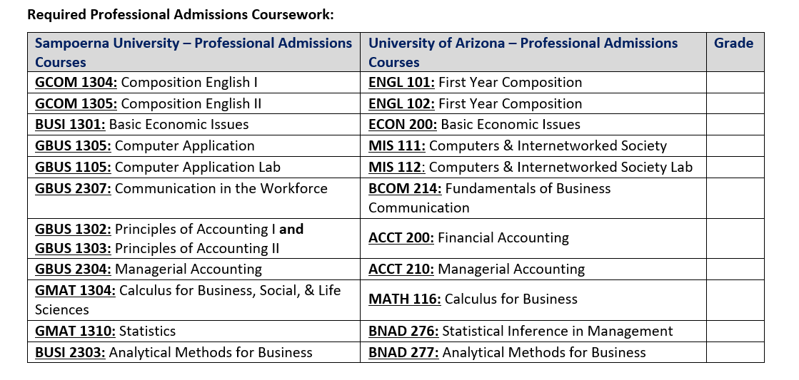
DUAL DEGREES OFFERED
BS Business Administration
Notes:
Katelyn
Here are the degrees we offer at AUPP and SU. Please note that for each program, you will be assigned a UA Academic Advisor. The advisors are experts when it comes to knowing your specific study plan and degree requirements. They are also the ones who check that you have met all requirements for graduation. We will share contact info with you later, but please know that this is another person on the UA side who is here to support your academic journey.
On the next slide, we will talk about the different types of degree requirements.

Slide 21
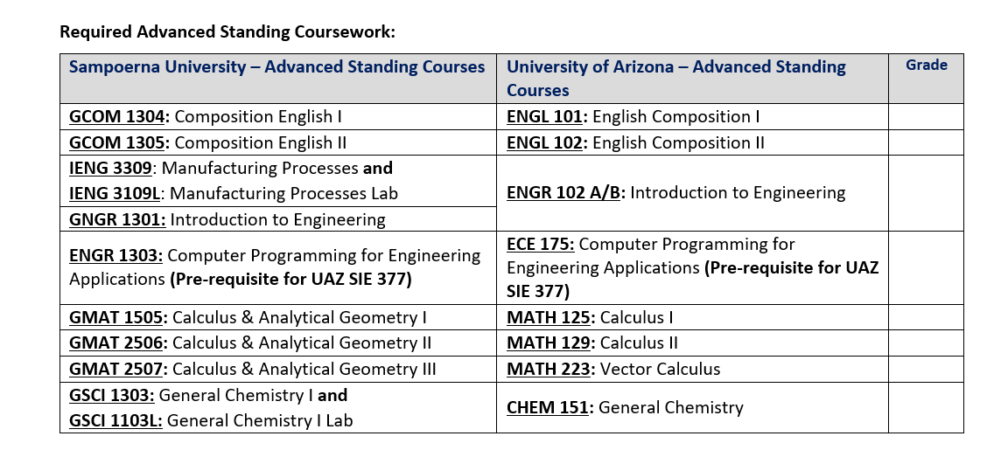
DUAL DEGREES OFFERED
BS Industrial Engineering
Notes:
Katelyn
Here are the degrees we offer at AUPP and SU. Please note that for each program, you will be assigned a UA Academic Advisor. The advisors are experts when it comes to knowing your specific study plan and degree requirements. They are also the ones who check that you have met all requirements for graduation. We will share contact info with you later, but please know that this is another person on the UA side who is here to support your academic journey.
On the next slide, we will talk about the different types of degree requirements.

Slide 22
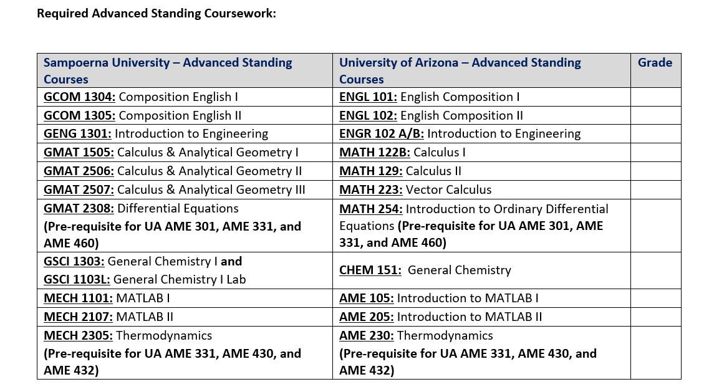
DUAL DEGREES OFFERED
BS Mechanical Engineering
Notes:
Katelyn
Here are the degrees we offer at AUPP and SU. Please note that for each program, you will be assigned a UA Academic Advisor. The advisors are experts when it comes to knowing your specific study plan and degree requirements. They are also the ones who check that you have met all requirements for graduation. We will share contact info with you later, but please know that this is another person on the UA side who is here to support your academic journey.
On the next slide, we will talk about the different types of degree requirements.

Slide 23
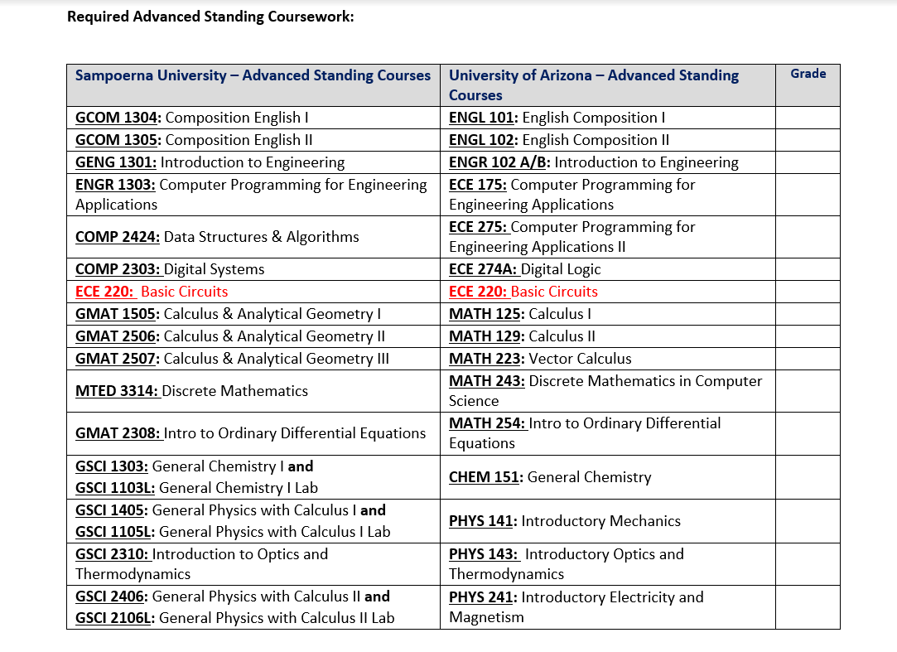
DUAL DEGREES OFFERED
BS ECE
Notes:
Katelyn
Here are the degrees we offer at AUPP and SU. Please note that for each program, you will be assigned a UA Academic Advisor. The advisors are experts when it comes to knowing your specific study plan and degree requirements. They are also the ones who check that you have met all requirements for graduation. We will share contact info with you later, but please know that this is another person on the UA side who is here to support your academic journey.
On the next slide, we will talk about the different types of degree requirements.

Slide 24
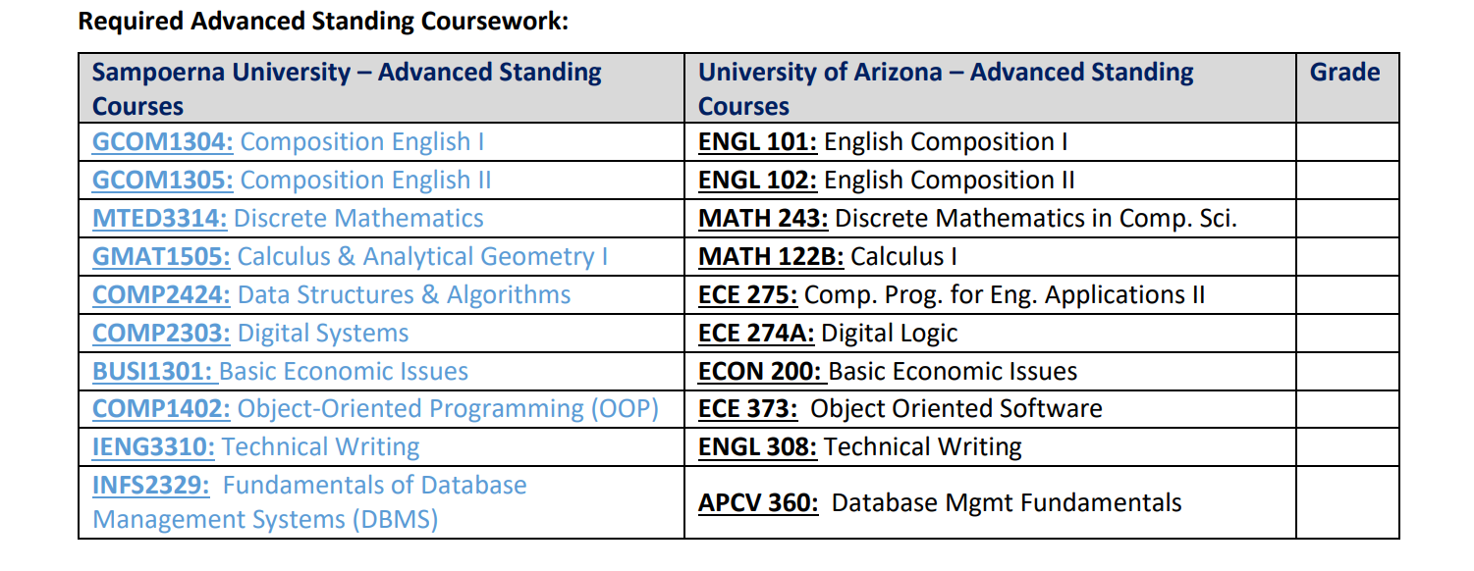
DUAL DEGREES OFFERED
BS Applied Computing
Notes:
Katelyn
Here are the degrees we offer at AUPP and SU. Please note that for each program, you will be assigned a UA Academic Advisor. The advisors are experts when it comes to knowing your specific study plan and degree requirements. They are also the ones who check that you have met all requirements for graduation. We will share contact info with you later, but please know that this is another person on the UA side who is here to support your academic journey.
On the next slide, we will talk about the different types of degree requirements.

Slide 25
UA Degree Requirements
Requirements at UA may vary from those at your home institution!
Study Plan
  Must complete all required courses
  Must take 30 units/credits with UA
  Engineering and Business students will need to take specific, foundational classes before they can enroll in upper division coursework with UA
Notes:
Katelyn
UA degree requirements vary between programs. We have students from 6 programs participating today so I will not go into specifics, but here are the 3 areas you need to be aware of for degree completion. We have many documents and checklists with specific requirements that we can give you at a later date.
Study plan: your study plans are pretty strict and there is not too much wiggle room for shifting classes around due to the fact that some UA courses are only taught certain semesters and also because there are many UA courses that are prerequisites for future UA courses you need to take. There are a few things to note here that apply to all of you. 1) You need to take all courses in the study plan 2) you need to take the courses at the designated location, even though courses transfer to each institution, you need to take the UA ones because in order to earn a degree from the UA, 30 units have to be UA taught.
If you are an Engineering or Business student, you really need to follow the study plan because you will be undergoing Advanced Standing or Professional Admissions review if you haven’t already. Long story short, there are specific courses that you need to take in order to begin upper division coursework at the UA. Just another reason why you need to pay attention to the study plan.
Other things to note here are that only C or higher grades from home institution will transfer to UA so you need to perform well in your local classes and also D grades in UA courses are technically passing, but may need to be taken again if your GPA is borderline. We’ll talk about GPA in a minute.
Something else you should know is that you will automatically be enrolled in your UA courses so ignore any messages you receive regarding drop/add dates. BTW you will get a lot of emails that don’t apply to you so if you receive something strange, fwd the email to your location manager. Lastly, super important, do not drop a course without consulting with your location manager. Again, since your study plan is strict, we need to set up a game plan right away if you need to deviate from the study plan.
Units for Graduation is another area you will need to keep an eye on. Each program requires a minimum total number of units earned to graduate. This total includes your UA courses and home courses. For most programs, the total is 120, but some require a little more like 124 or 128. Again, you will receive documentation stating what your unit requirement is.
GPA is by far the most important area you need to focus on as it is not easy to fix if it’s not meeting standards. There are a few different types of GPAs that you will be required to meet. I’m not going to state any numbers because they vary between programs and I don’t want to confuse anyone or through too much information at you all. I will just describe the different types.
The first is the general admissions GPA, which is the GPA you need to be admitted into the UA as a transfer student. You all have already met so congrats!
The next GPA evaluation will come when you are under Advanced Standing or Professional Admissions review. Only the Engineering and Business students need to worry about this -- this does not apply to Law students. As I briefly stated before, in order to start upper division coursework with your program, you have to complete a number of specific courses. You will also need to obtain a specific GPA in those courses.
Another GPA you may need to be concerned with is called a term GPA. I can describe this best by giving an example. You will all be enrolled with the UA for 4 semesters. For Mechanical students, in one of those 4 semesters, you will have to earn a 2.5 UA term GPA. UA term GPA is calculated by only looking at the UA courses you took in that one term. So it’ll be a GPA comprised of 3-4 of your UA grades. Not every program has this requirement, but some do.
The next important GPA is your UA Major GPA. This includes all major courses you take at UA. So for example, Industrial students, this is all of your SIE courses you take at UA so if you take a course with the subject code of SIE -- the grade of that course will be counted into this major UA GPA.
The last one here is the cumulative UA GPA. This includes all UA coursework -- major and non-major. You guys basically only take major courses with UA, so this GPA and your major UA GPA will usually always be the same.
As you can see, there’s a lot of requirements you will need to meet and keep track of. You must meet all of these requirements! Even if you miss just one, the UA will not grant your degree and you will need to resolve the missing item before you can graduate which usually will cause your graduation term to be deferred, which is not fun. I through a lot at you here so please ask any questions you may have in the chat and I will answer them as soon as I’m done with this section.

Slide 26
UA Degree Requirements
Study Plan
  Only courses with C or higher grades transfer into UA
  D grades in UA courses are technically passing, but may need to be retaken depending on your specific programs’ policies
  You will automatically be enrolled in your UA courses -- you do not need to do this yourself
  Do not drop any courses without consulting with your advisor and UA location manager
Notes:
Katelyn
Other things to note here are that only C or higher grades from home institution will transfer to UA so you need to perform well in your local classes and also D grades in UA courses are technically passing, but may need to be taken again if your GPA is borderline. We’ll talk about GPA in a minute.
Something else you should know is that you will automatically be enrolled in your UA courses so ignore any messages you receive regarding drop/add dates. BTW you will get a lot of emails that don’t apply to you so if you receive something strange, fwd the email to your location manager. Lastly, super important, do not drop a course without consulting with your location manager. Again, since your study plan is strict, we need to set up a game plan right away if you need to deviate from the study plan.
Units for Graduation is another area you will need to keep an eye on. Each program requires a minimum total number of units earned to graduate. This total includes your UA courses and home courses. For most programs, the total is 120, but some require a little more like 124 or 128. Again, you will receive documentation stating what your unit requirement is.
GPA is by far the most important area you need to focus on as it is not easy to fix if it’s not meeting standards. There are a few different types of GPAs that you will be required to meet. I’m not going to state any numbers because they vary between programs and I don’t want to confuse anyone or through too much information at you all. I will just describe the different types.
The first is the general admissions GPA, which is the GPA you need to be admitted into the UA as a transfer student. You all have already met so congrats!
The next GPA evaluation will come when you are under Advanced Standing or Professional Admissions review. Only the Engineering and Business students need to worry about this -- this does not apply to Law students. As I briefly stated before, in order to start upper division coursework with your program, you have to complete a number of specific courses. You will also need to obtain a specific GPA in those courses.
Another GPA you may need to be concerned with is called a term GPA. I can describe this best by giving an example. You will all be enrolled with the UA for 4 semesters. For Mechanical students, in one of those 4 semesters, you will have to earn a 2.5 UA term GPA. UA term GPA is calculated by only looking at the UA courses you took in that one term. So it’ll be a GPA comprised of 3-4 of your UA grades. Not every program has this requirement, but some do.
The next important GPA is your UA Major GPA. This includes all major courses you take at UA. So for example, Industrial students, this is all of your SIE courses you take at UA so if you take a course with the subject code of SIE -- the grade of that course will be counted into this major UA GPA.
The last one here is the cumulative UA GPA. This includes all UA coursework -- major and non-major. You guys basically only take major courses with UA, so this GPA and your major UA GPA will usually always be the same.
As you can see, there’s a lot of requirements you will need to meet and keep track of. You must meet all of these requirements! Even if you miss just one, the UA will not grant your degree and you will need to resolve the missing item before you can graduate which usually will cause your graduation term to be deferred, which is not fun. I through a lot at you here so please ask any questions you may have in the chat and I will answer them as soon as I’m done with this section.

Slide 27
UA Degree Requirements
Units/Credits for Graduation (120-128)
GPA
  General Admission GPA
    GPA required for admission into the UA
  Departmental Review GPA
    GPA required when undergoing departmental review into the college (Engineering and Business)
  Cumulative UA GPA
    2.0 minimum required to graduate
    Includes all UA coursework
    Does not include transfer grades
Notes:
Katelyn
Units for Graduation is another area you will need to keep an eye on. Each program requires a minimum total number of units earned to graduate. This total includes your UA courses and home courses. For most programs, the total is 120, but some require a little more like 124 or 128. Again, you will receive documentation stating what your unit requirement is.
GPA is by far the most important area you need to focus on as it is not easy to fix if it’s not meeting standards. There are a few different types of GPAs that you will be required to meet. I’m not going to state any numbers because they vary between programs and I don’t want to confuse anyone or through too much information at you all. I will just describe the different types.
The first is the general admissions GPA, which is the GPA you need to be admitted into the UA as a transfer student. You all have already met so congrats!
The next GPA evaluation will come when you are under Advanced Standing or Professional Admissions review. Only the Engineering and Business students need to worry about this -- this does not apply to Law students. As I briefly stated before, in order to start upper division coursework with your program, you have to complete a number of specific courses. You will also need to obtain a specific GPA in those courses.
The last one here is the cumulative UA GPA. This includes all UA coursework -- major and non-major. You guys basically only take major courses with UA, so this GPA and your major UA GPA will usually always be the same.

Slide 28
UA Degree Requirements
Summary
Must pass all required courses with a C grade or higher
Must achieve minimum GPA
Must complete unit/credit requirements
The UA will not award your degree if these requirements are not met!
Notes:
Katelyn
As you can see, there’s a lot of requirements you will need to meet and keep track of. You must meet all of these requirements! Even if you miss just one, the UA will not grant your degree and you will need to resolve the missing item before you can graduate which usually will cause your graduation term to be deferred, which is not fun. There are some tools you can use to monitor your UA degree progress. The graduation checklists are one of them and you will learn about others that are in your UAccess Student Center in the HED course.
I threw a lot at you here so please ask any questions you may have in the chat and I will answer them as soon as I’m done with this section.

Slide 29
UA Graduation Timeline
Complete all degree requirements
Participate in UA graduation ceremonies
  You have not earned your degree yet at this point in time, and will not receive a diploma yet.
Final degree check by Academic Advisor
Degree conferral by Graduation Services
Diploma routed to Arizona International and then shipped to home institution
You will receive your diploma 2-3 months after graduation ceremony.
Notes:
Katelyn
Although graduation is 2 - 3 years away for you all, we think it’s important to tell you a little bit about how it works at the UA because we have seen in the past that it may work a little differently than your home institution…..
**read off slide and be sure to mention that graduation ceremonies do not mean they have earned their degree**
…..as you can see it can take awhile for your degree to post and for you to receive your diploma. If you need proof for employers, there are a few things we can do to provide documentation so don’t worry about that.

Slide 30

Notes:
Katelyn
Here is what the diploma looks like and that will be your name on it soon!!
So I talked about all of the requirements you need to keep track of, but I did not explain how to do so yet so we will take a break from this, Amanda will go over D2L and the Student Center, and come back to how to track your progress.

Slide 31
D2L
(Desire to Learn)
This will be an overview of the learning
platform that the University of Arizona uses.
Notes:
Thuy
-How to log in: https://d2l.arizona.edu/d2l/loginh/
-D2L Overview video on Panopto:
https://arizona.hosted.panopto.com/Panopto/Pages/Viewer.aspx?id=f8acb91e-2aa9-42fb-97e0-abd600405b8f
*** Amanda to insert embedded link ***
Hi everyone!
As I mentioned before, my name is Amanda for whoever came in a little late and didn’t catch that. I have the pleasure of explaining D2L to all of you today. D2L is amazing because you can do soooo many things on it!

Slide 32
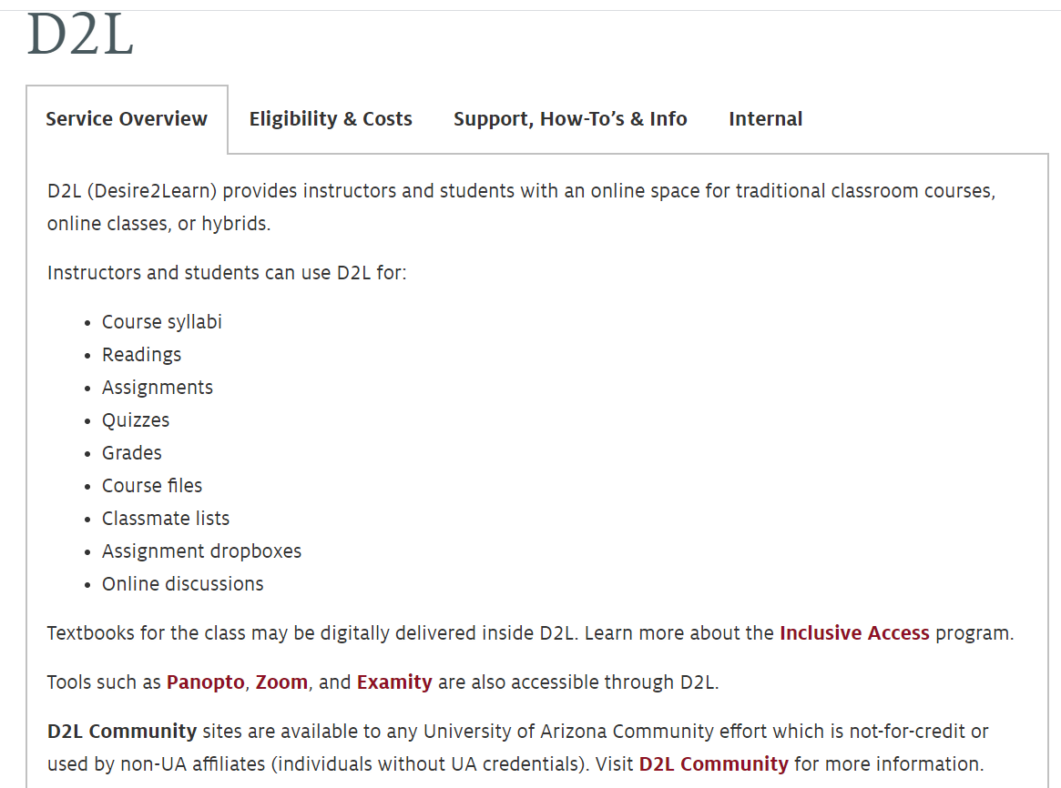
D2L Overview
D2L stands for Desire to Learn. This is the online educational platform that the University of Arizona uses for all courses. Please remember to take your time and be patient while learning to use D2L.
Notes:
Thuy

Slide 33
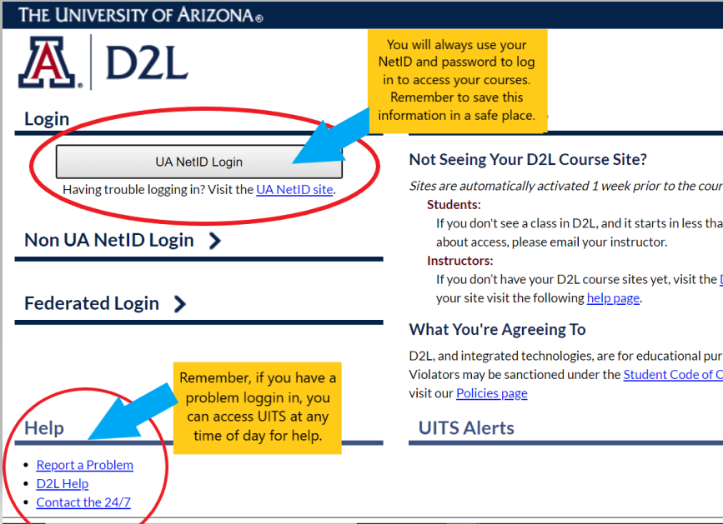
Logging into D2L
To log into D2L and access your courses, you will always refer to the following website:https://d2l.arizona.edu/d2l/login
Notes:
Thuy

Slide 34
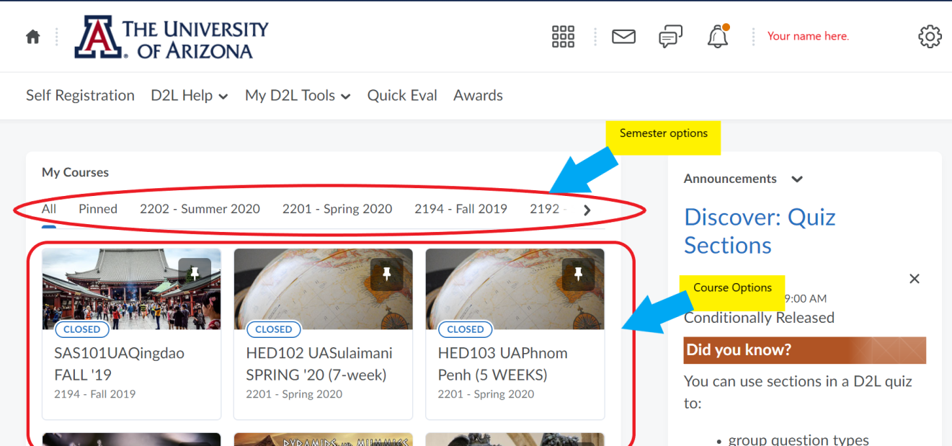
Accessing Your Courses
Once you log in, your D2L home page will look similar to the picture below. Click on the correct “semester,” as well as the correct D2L course. There will likely be
more than one option.
Notes:
Thuy

Slide 35
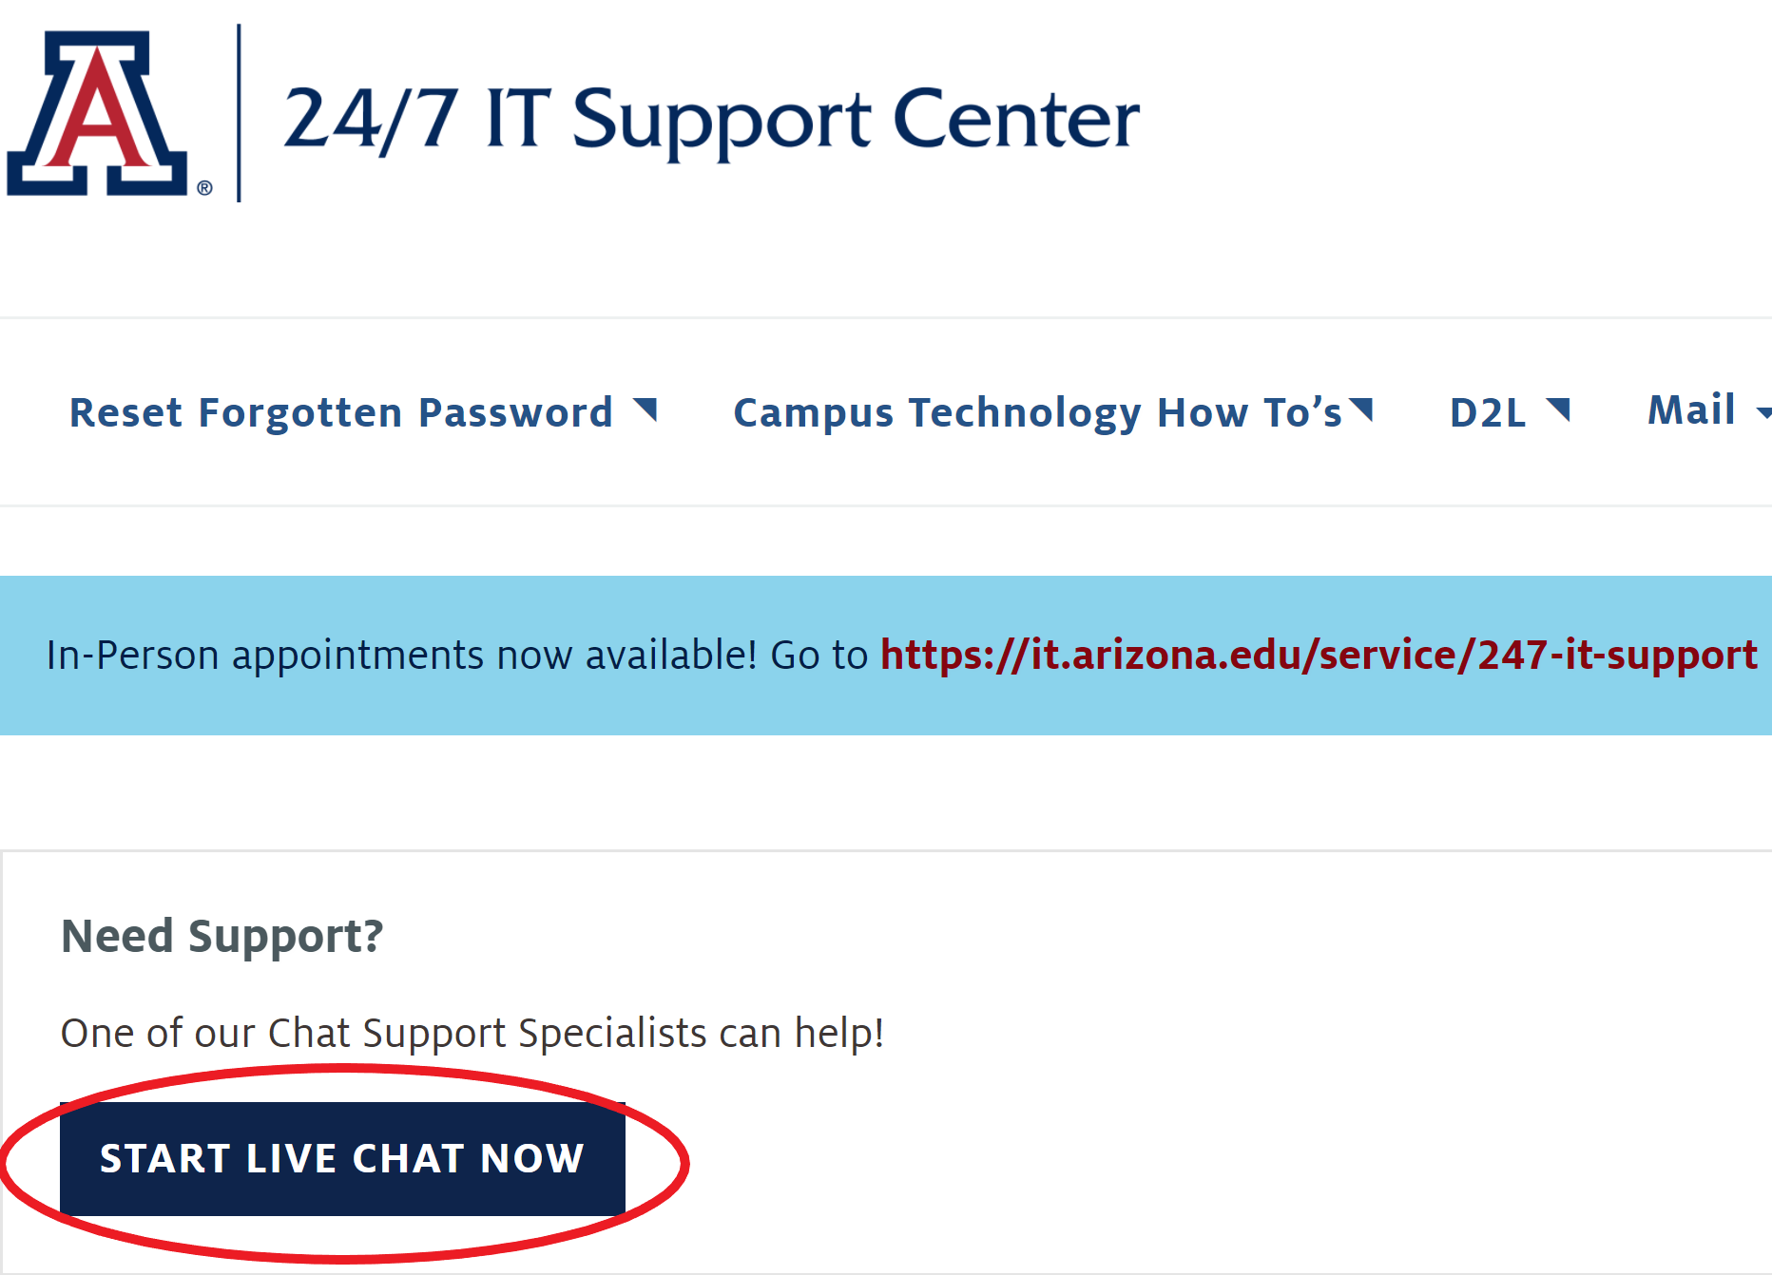
Need Help with D2L?
If you need help with logging in, contact the 24/7 IT Support through the live online chat feature @ support.arizona.edu
If you need assistance in a particular UA course site, contact your professor.
Notes:
Thuy

Slide 36
How to Navigate the
UAccess Student Center
This will be a brief explanation of UAccess and how students can explore their transcripts, grades,
GPA, and more personal student information.
Notes:
Thuy
Go over tabs at the top
How to change a name on Uaccess (get new screenshots of this)

Slide 37
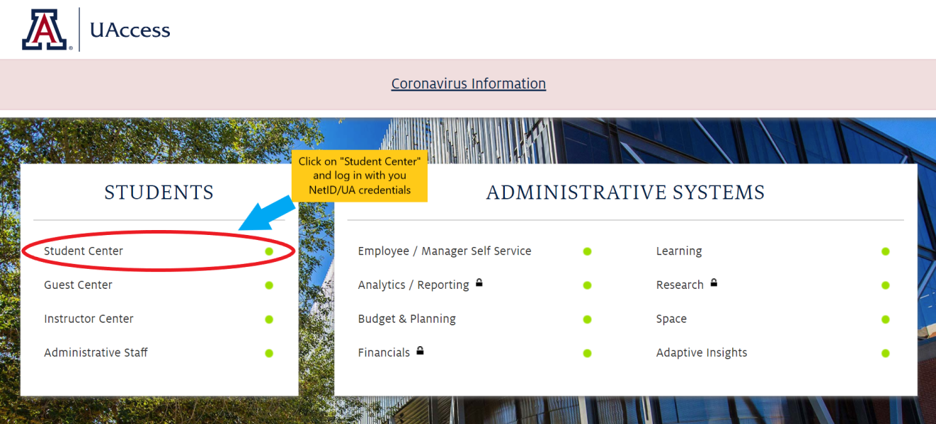
Logging into UAccess
When trying to access your student information on UAccess, you will always use the following website: uaccess.arizona.edu
Notes:
Thuy

Slide 38
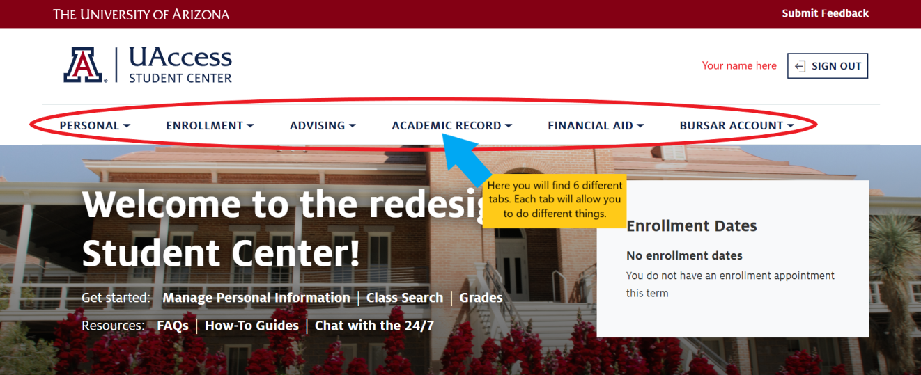
UAccess Dashboard
Once you have logged into UAccess, you will be brought to your UAccess homepage (dashboard). Here there are many options. Refer to the 6 different tabs at
the top of the page to guide you.
Notes:
Thuy

Slide 39
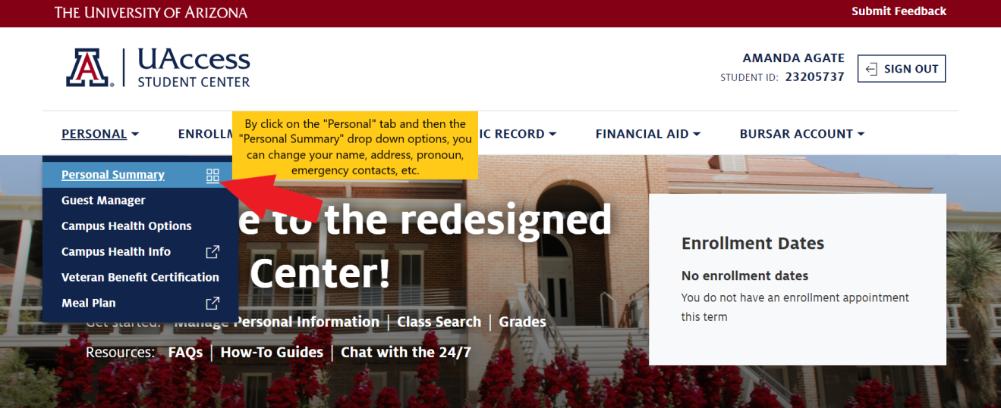
Personal Information
Under the “Personal” tab, you can change your name, your marital status, your address, your pronouns,
your emergency contact, and more.
Your name here
Notes:
Thuy

Slide 40
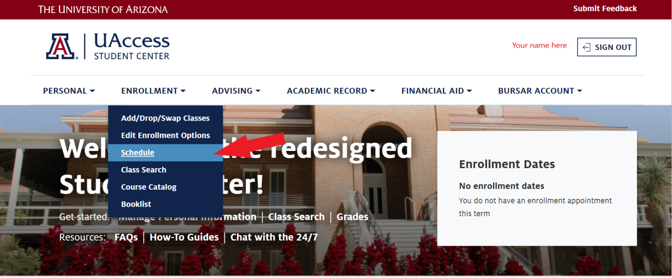
Course Schedule
By clicking the “Enrollment” tab and then selecting “Schedule” from the drop down menu, you will be able to view your course schedule.
Notes:
Thuy

Slide 41
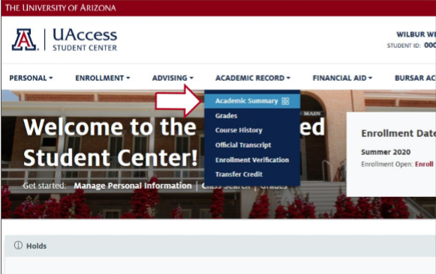
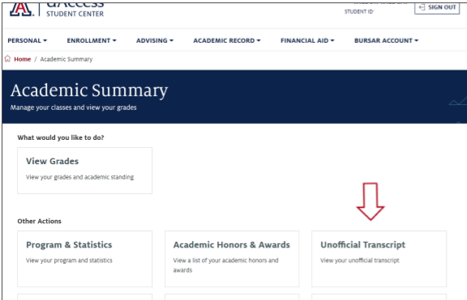
Academic Record
By clicking on the “Academic Record” tab, you will be able to access your transcripts, course history, grades, enrollment verification, and more.
Notes:
How to view your unofficial/official transcript (get new screenshots of this)

Slide 42
D2L Support
You will learn more about the Student Center in your student success course with the UA: HED 102A/B.
If you need assistance with something in the meantime, you can view the Student Center How-To Guide here:
https://it.arizona.edu/documentation/student-center-how-tos
Notes:
Thuy

Slide 43
Student Resources
A list of helpful resources and checklists.
Notes:
What are other student resources that are available to UA students that you should be aware of

Slide 44
Arizona Global Librarians
The Arizona Global Librarian is a librarian at your home institution who has full access to the UA Library to help you find UA resources, services, and tutorials that will help you with your studies and research.
SU - Narfiyan Wahyudi
(narfiyan.wahyudi@sampoernauniversity.ac.id)
Notes:
(Susan)
The UA has tons of open source resources you can utilize for research as well as tutorials for information literacy, citing & plagiarism, APA/MLA formatting, conducting effective search strategies, etc.
The contact info for your assigned librarian is on the screen.
You will learn more about library resources in HED.

Slide 45
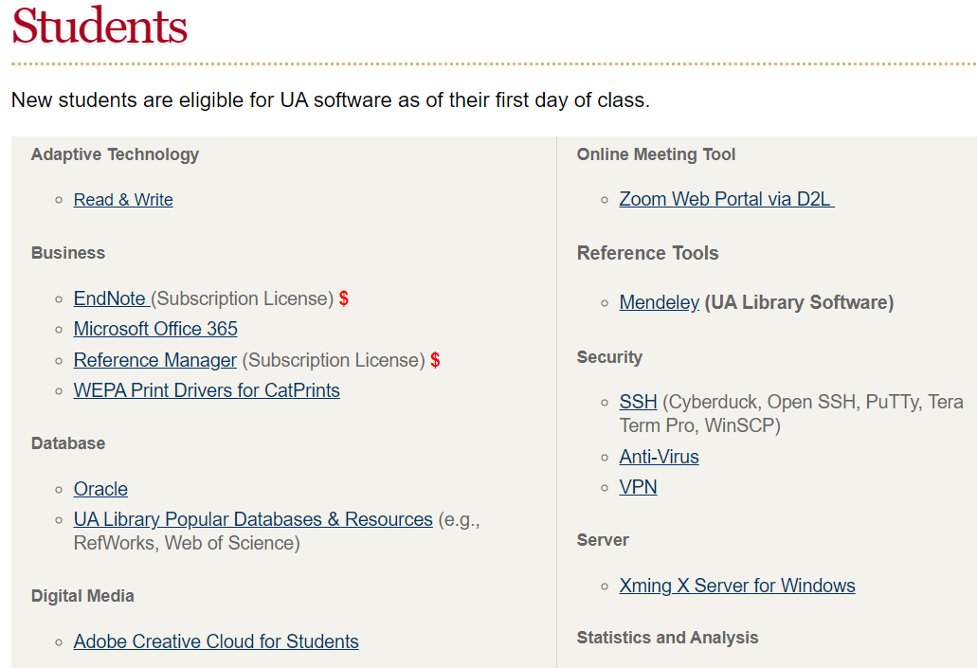
Links to Software
The University of Arizona provides an organized list containing links to all of the Software Licensing that you can access as a UA student.
https://softwarelicense.arizona.edu/students
Notes:
as a university of arizona student, you will have access to a lot of free software.
You can download the software in this link and this is a list of software that is available to you.
Microsoft 365: Office 365 includes:
1TB of OneDrive online storage
Office software: Word, Excel, PowerPoint, OneNote
-Online, accessible from any browser, with files that can be shared for collaboration
-Downloadable desktop and mobile versions for up to on 5 PCs or Macs, 5 tablets (Windows, iPad, and Android), and 5 phones
Delve, Sharepoint, Sway, Forms, Planner, Video, SharePoint, Newsfeed, Yammer

Slide 46

https://thinktank.arizona.edu/
Notes:
Beside free software, microcampus students also have access to academic support.
Think Tank is the University of Arizona Academic support service that is available online via Zoom.
Here you can see a list of academic support available.
Some service is free and some come with a fee.
Most students make use of the Writing support for assignments, Tutoring for specific subject, and exam preparation.

Slide 47
Staying Connected
Stay connected and plugged into the “know” by following and checking the
following sources related the University of Arizona and Arizona Global:
Arizona Global Website
The University of Arizona on Instagram
The University of Arizona on Twitter
U of A sports teams on Instagram
U of A Admission on Instagram
#UAGlobal on Instagram
The University of Arizona on Facebook
#GlobalWildcats on Facebook
Notes:
Finally, please keep in touch and follow us on social media.
There are social media accounts dedicate to UA Phnom Penh and UA Jakarta students that we hope you have followed already. Besides that, these are other UA accounts that you can follow to keep yourself connected with the bigger Arizona global network

Slide 48
FAQs
Q: Will the software that we can download through the UA expire at the end of the semester, or will it continue until our last year at UA?
A: You will be able to utilize the software provided by the UA until your UA email is deactivated. Your UA email is eventually deactivated after you graduate.
Notes:
The UA has tons of open source resources you can utilize for research as well as tutorials for information literacy, citing & plagiarism, APA/MLA formatting, conducting effective search strategies, etc.
The contact info for your assigned librarian is on the screen.

Slide 49

QUESTIONS?
Notes:
Amanda
Thank you for joining us today. This is the end of our Orientation for you. Now, if you have any questions, we are here to answer

