Slide 1
SIE Degree Requirements and Graduation Steps

Slide 2
Your Support System at U of A
Graduate Student Academic Services, Arizona International, and Systems & Industrial Engineering:
  Review and Approves your GradPath Forms
  Process Transfer Credit Evaluation Forms
  Ensure the Graduate Departments and students are in compliance with policy
  Review and audits your degree
  Award your degree after final review
  Provide Certificate of Completion

Slide 3
Graduation Flow Chart
1. Finish your U of A + PSUT courses
2. Send your PSUT official transcripts to U of A
3. GradPath > FIRST - Submit your Transfer Credit Evaluation form listing PSUT courses
4. GradPath > Completing remaining GradPath forms and SIE MS Exit Survey
5. Graduate!
Notes:
Cindy

Slide 4
Engineering Management (MS) – 33 units total
18 units will be from U of A
UA Course Code | UA Course Name | Unit Totals
SIE 514 | Law for Engineers and Scientists | 3
SIE 515 | Technical Sales & Marketing | 3
SIE 522 | Engineering Decision Making Under Uncertainty | 3
SIE 557 | Project Management | 3
SIE 567 | Financial Modeling for Innovation | 3
SIE 565 | Supply Chain Management | 3
Notes:
The course requirements we sharing are to earn the UA degree ONLY. PSUT may have different graduation requirements to earn their degree.

Slide 5
Engineering Management (MS) – 33 units total
15 units will be from PSUT
PSUT Course Number | PSUT Course Name | Unit Totals
26723 | Mathematical Decision Making | 3
26790 | Advanced Topics in Engineering Management | 3
Elective Courses (take 3 of these courses)
13742 | Enterprise Systems Architecture | 3
13746 | Testing/Quality Management | 3
33758 | People Leadership/Human Resource Management | 3
13743 | Cloud Computing & Big Data | 3
33773 | Management of Innovation | 3
33772 | New Product Development | 3
33762 | Strategic Management of Entrepreneurial Organization | 3
Notes:
Note that only 3 electives from PSUT are required to earn the UA degree. PSUT may require you to take more than 3 of the electives listed here.

Slide 6
Am I eligible to graduate ?
Cumulative U of A GPA
Cumulative GPA is a 3.00
All U of A SIE courses are at least "C" grade or higher
Enrollment
Enrolled in at least 1.00 graduate credit hour in graduation term at U of A
GradPath
Complete all GradPath forms, which we will go over now!
All PSUT courses are "B" grade or higher after conversion
Notes:
Cindy

Slide 7
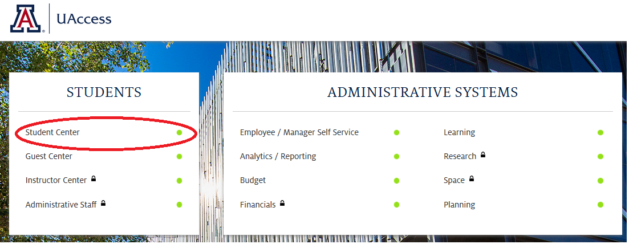
How do I navigate GradPath?
uaccess.arizona.edu
Click on ‘Student Center’
Log in with your U of A NetID and Password
  NOT your 8 digit student ID number
Notes:
Lupita/Megan

Slide 8
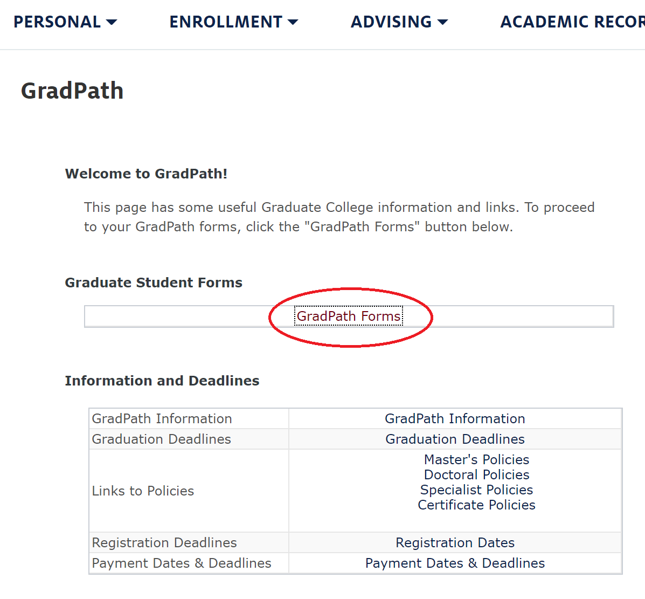
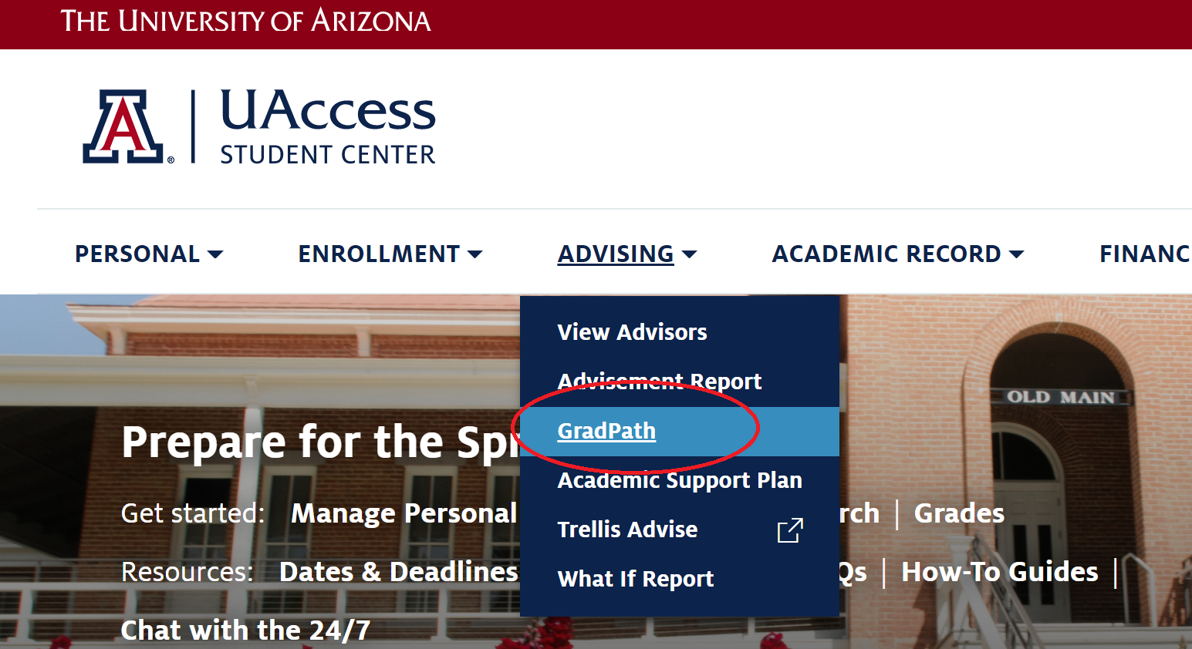
How do I navigate GradPath?
Notes:
Lupita/Megan

Slide 9
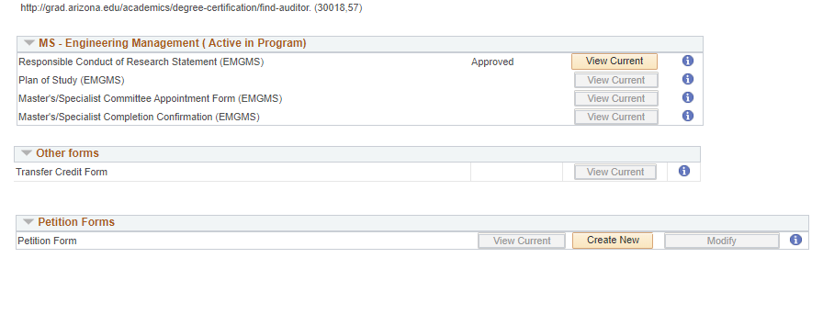
GradPath: Home Page
Notes:
Lupita/Megan

Slide 10
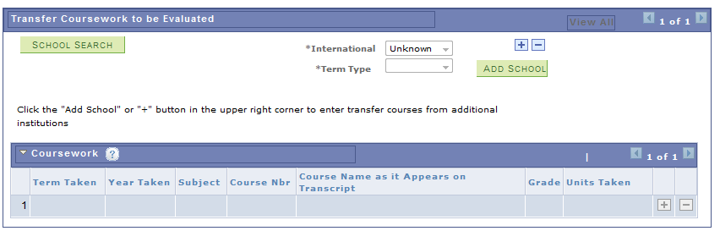
GradPath: Transfer Credit Evaluation Form
Select 'School Search' and search for PSUT
Next to 'International,' select 'Yes'
Next to 'Term Type,' select 'Semester'
Add 5 approved PSUT courses
  Term taken (I.e.: Fall)
  Year (I.e.: 2022)
  Subject – No subject
  Course number (I.e.: 26723)
  Course name as it appears on transcript (I.e.: Mathematical Decision Making)
  Grade earned as it appears on transcript
  Units earned as they appear on transcript
Do not convert the grades and units
Graduate College will review
Notes:
Lupita/Megan

Slide 11
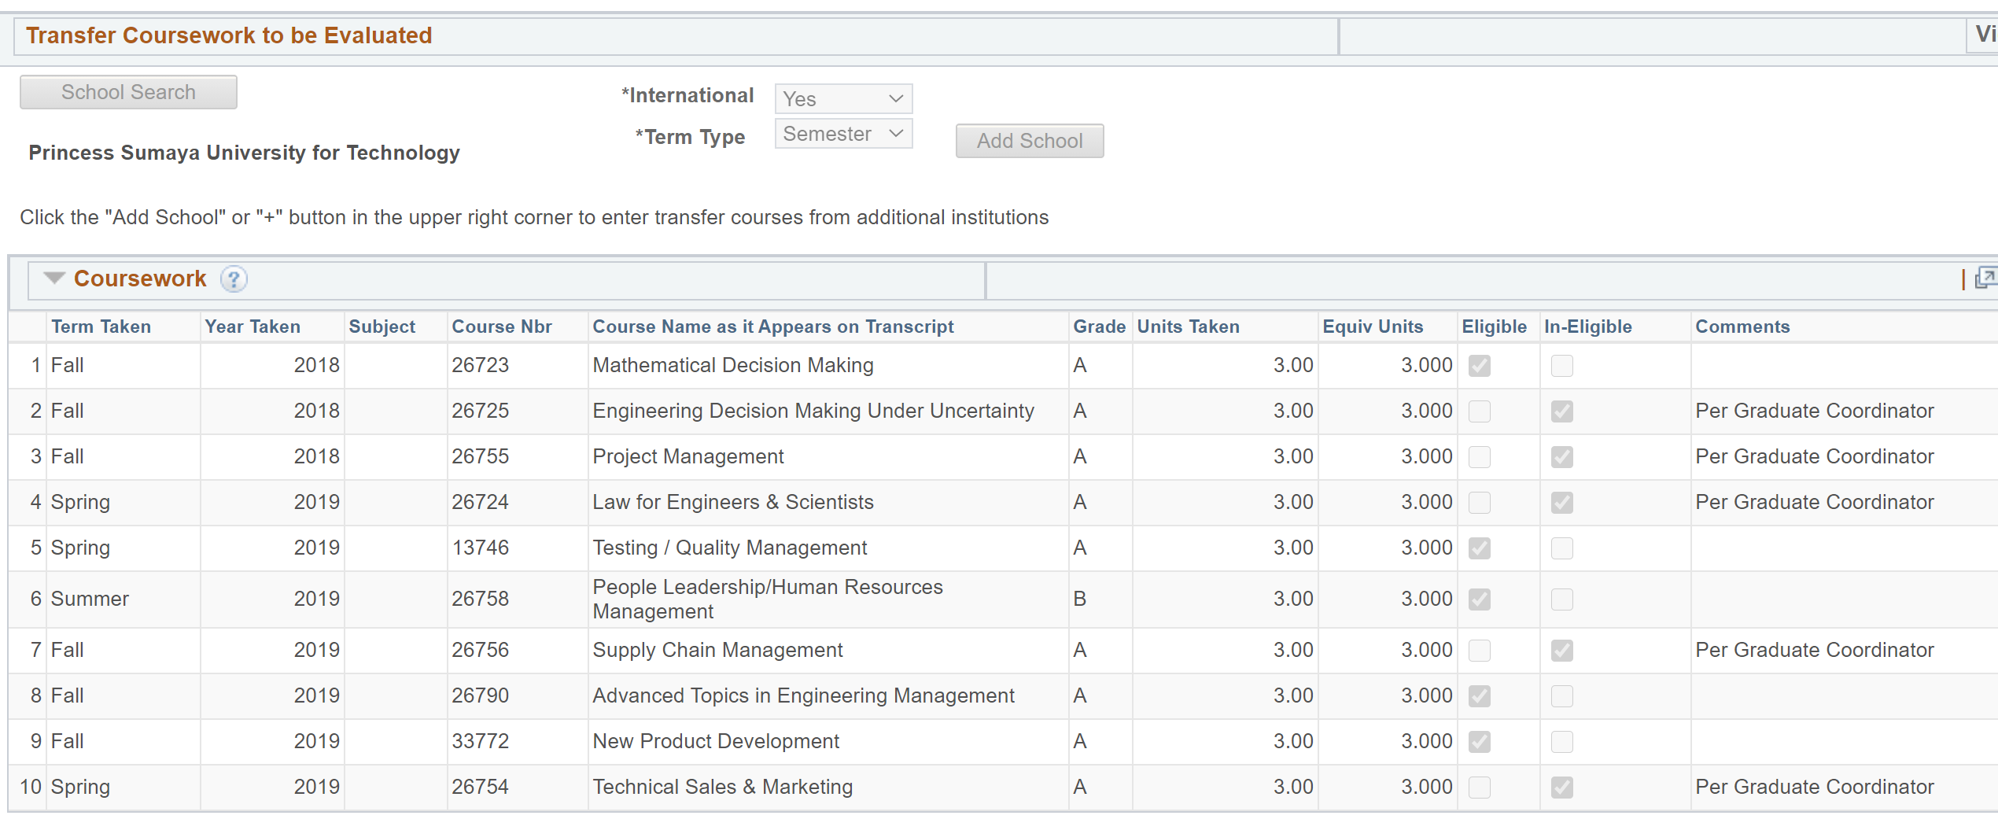
GradPath: Transfer Credit Evaluation Form
1. School Search: Princess Sumaya University for Technology
2. International: Yes
3. Term Type: Semester
This is where the 15 PSUT transfer units are added to be used on U of A EMGMS MS Plan of Study
Notice that grades and units were reviewed by Graduate College
Notes:
Lupita/Megan

Slide 12
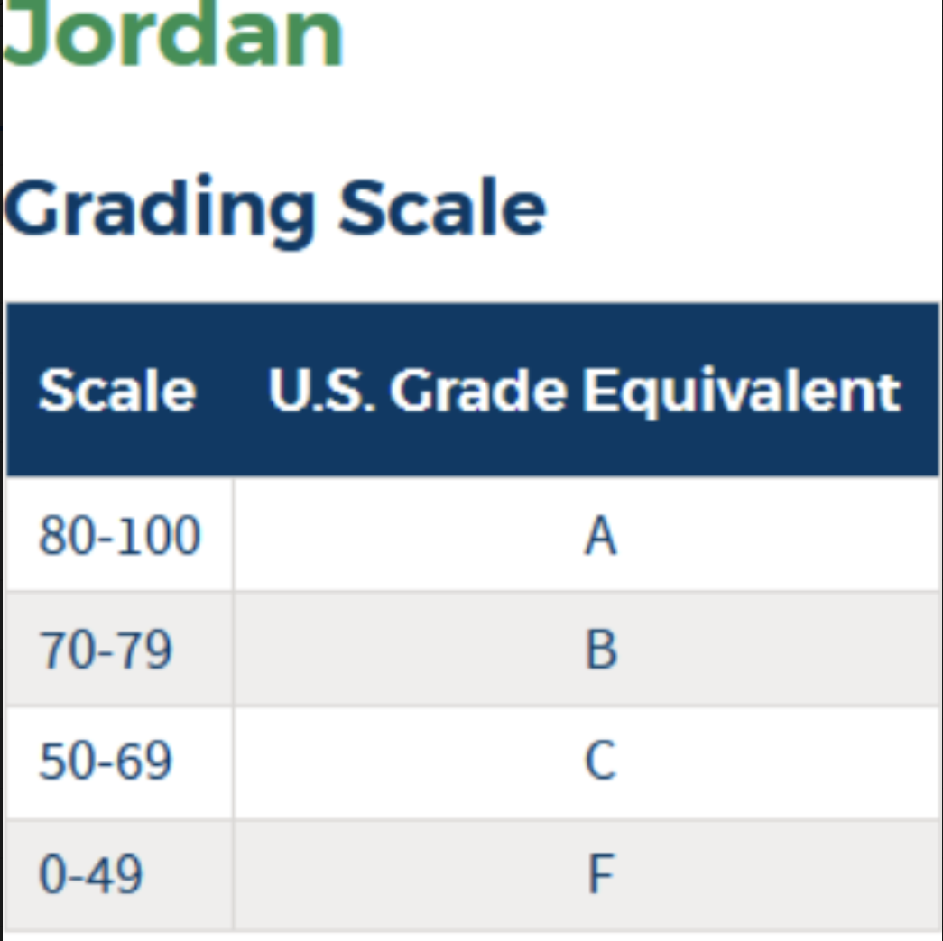
GradPath: Transfer Credit Evaluation Form
Remember, only grades equivalent to a B or higher will transfer into U of A.
Anything lower than a B equivalent will need to be retaken at PSUT before it will transfer in, and thus, before you can graduate from U of A.
Again, do not convert the grades on your Transfer Credit Evaluation Form yourself! GSAS will do this for you.
Notes:
Lupita/Megan

Slide 13
MS: GradPath
Student forms must be submitted in order. Each form has a routing process.
SIE Faculty Academic Advisor (Professor Michael Kwinn)
You are responsible for 3 of the 4 forms:
1. Responsible Conduct of Research
2. Plan of Study
3. Master’s/Specialist Committee Appointment Form
4. Master’s/Specialist Completion Confirmation
**You do not do this form. SIE will submit this to the Graduate College to confirm completion of department degree requirements.
Notes:
Lupita/Megan

Slide 14
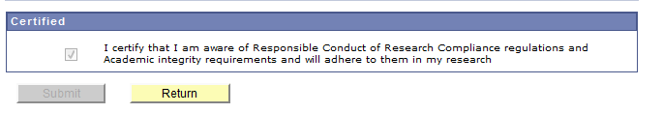
MS: GradPath
Responsible Conduct of Research
  This is the first GradPath form for all students
Until you complete this form, you will not have access to any of the other forms.
This form does not require any approval, so you will have access to the other forms immediately.
Notes:
Lupita/Megan

Slide 15
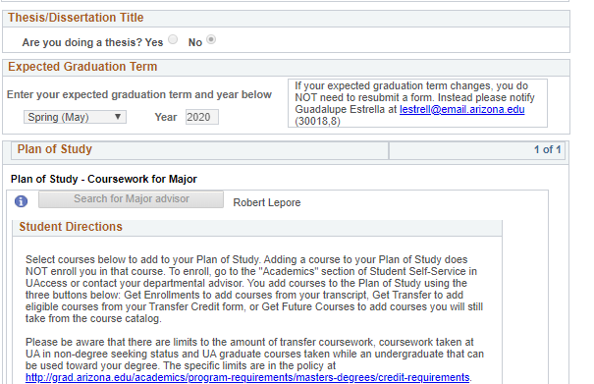
MS: GradPath -Plan of Study
On your Plan of Study:
Indicate that you are NOT doing a thesis.
Enter your Expected Graduation Term (EGT)
  If your EGT is different than what you see, you can change it here. Once Plan of Study is approved by the Graduate College, it will update the system
  If you finish courses in January, select Fall. If you finish courses in June, select Spring.
  Select the appropriate year (I.e. 2022, 2023, 2024, etc.)
Select your Faculty Advisor (Searching via first and last name is easiest): Michael Kwinn
Michael Kwinn

Slide 16
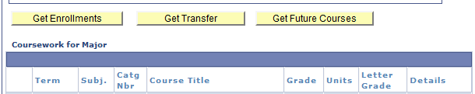
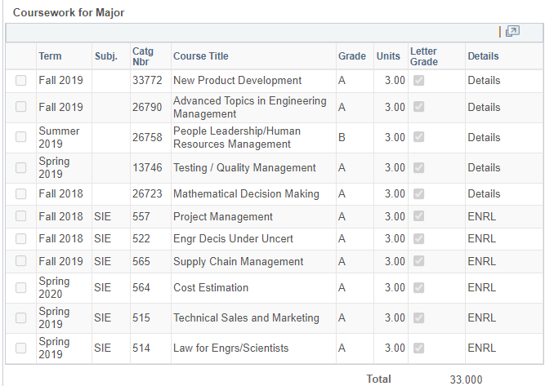
MS: GradPath -Plan of Study
List the courses needed to meet your degree requirements:
You can select from:
Get Enrollments – UA courses you have already taken
Get Future Courses - Do not use this
Get Transfer – Courses that have been approved through the Transfer Credit Evaluation form
(Transfer Credit Evaluation form must be submitted and courses must be verified before completing the Plan of Study form)
Notes:
Lupita/Megan

Slide 17
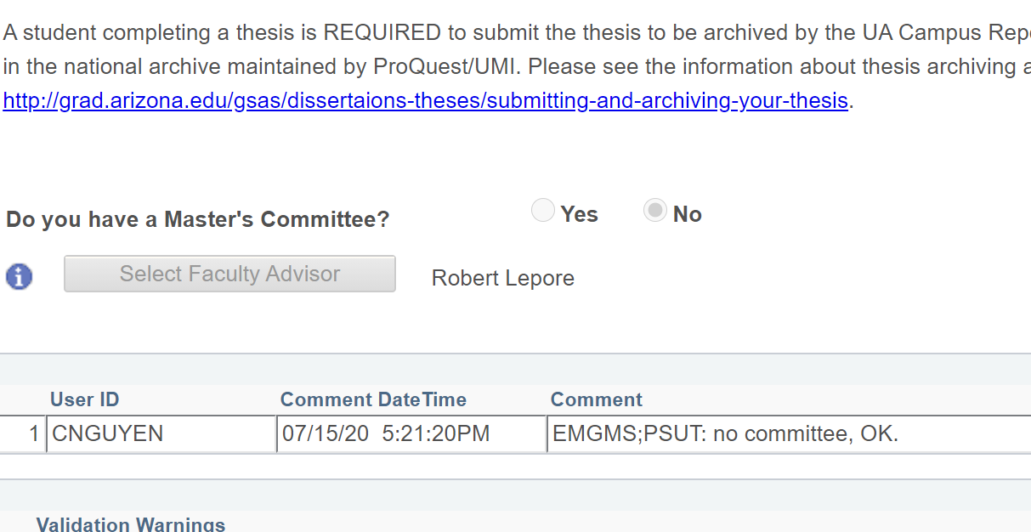
MS: GradPath – Master’s Committee Form
It will ask if you have a Master's/Specialist committee.
  Select "No"
This will auto-populate your faculty academic advisor's name.
Michael Kwinn
Notes:
Lupita/Megan

Slide 18
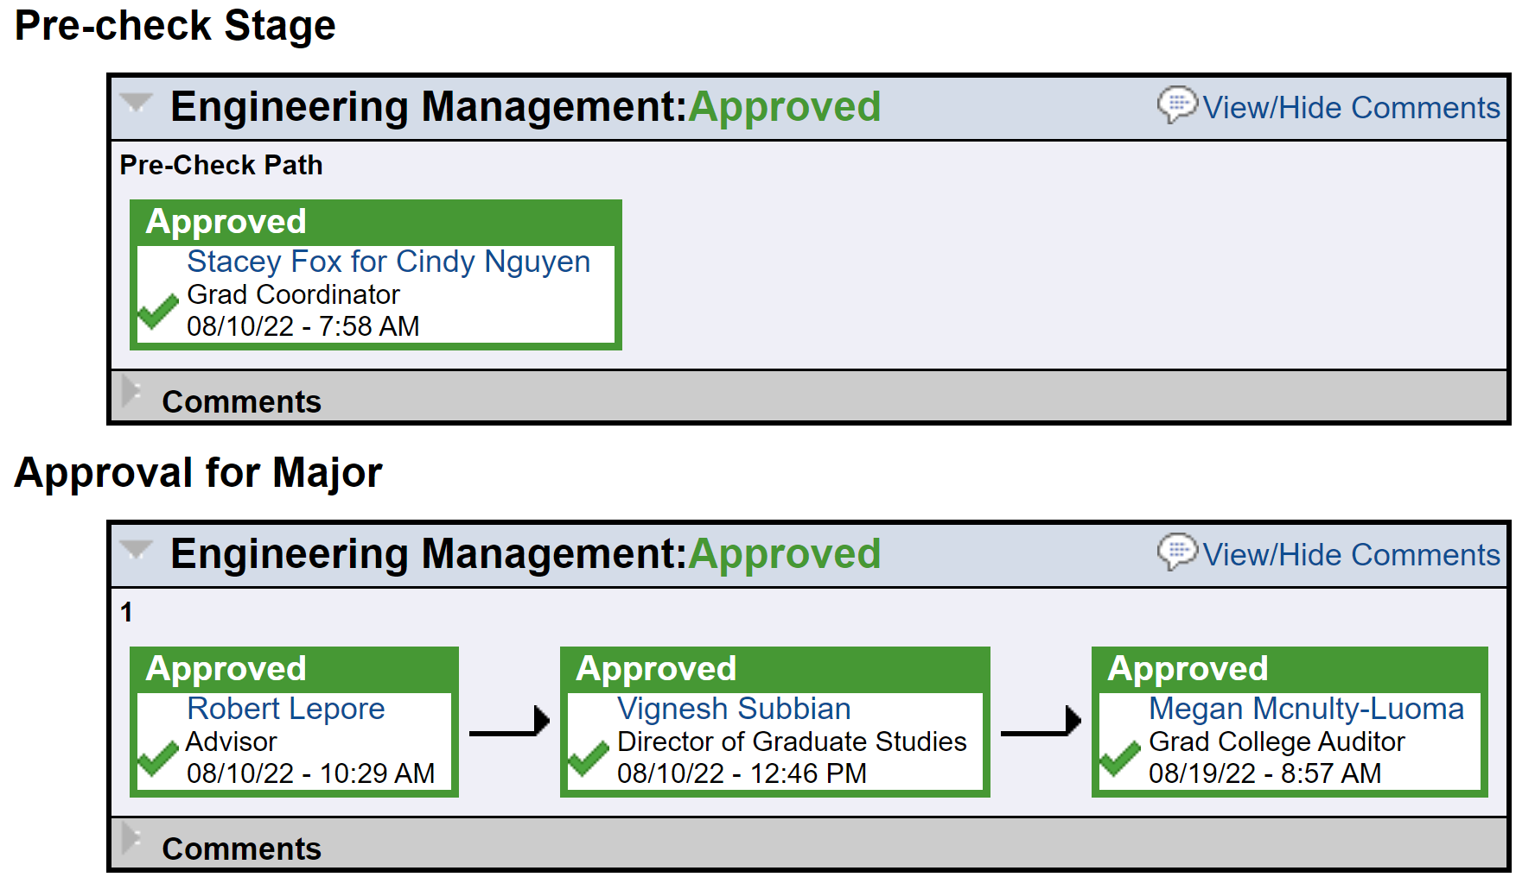

MS: GradPath - Routing
After you submit a form, you can scroll to the bottom of the form and see who has yet to make a decision and when they received the form.
When someone approves your form, it will route automatically to the next reviewer.
Notes:
Lupita/Megan

Slide 19
Frequently Asked Questions: GradPath
  My Expected Graduation Term (EGT) on UAccess indicates another term (i.e: It is listing Summer 2022 instead of Fall 2022): What do I do? Indicate your actual EGT on your plan of study. Once approved by the Graduate College, it will update in the system.
  I am submitting my Plan of Study but it says there's an error! I can't include more than 12 Transfer units but we need 15 Transfer PSUT units to graduate. Submit it anyway, Graduate College is aware that the program requires 15 transfer PSUT units.
  My classes end after the Graduate College program completion deadline for my expected graduation term, will that negatively impact my diploma? No, your diploma will still list the conferral date of your expected graduation term.
  How long does it take for me to receive my diploma once my degree is posted? ~ 4-6 weeks. AZ Intl will mail one batch to PSUT to make it easier.
Notes:
Cindy

Slide 20
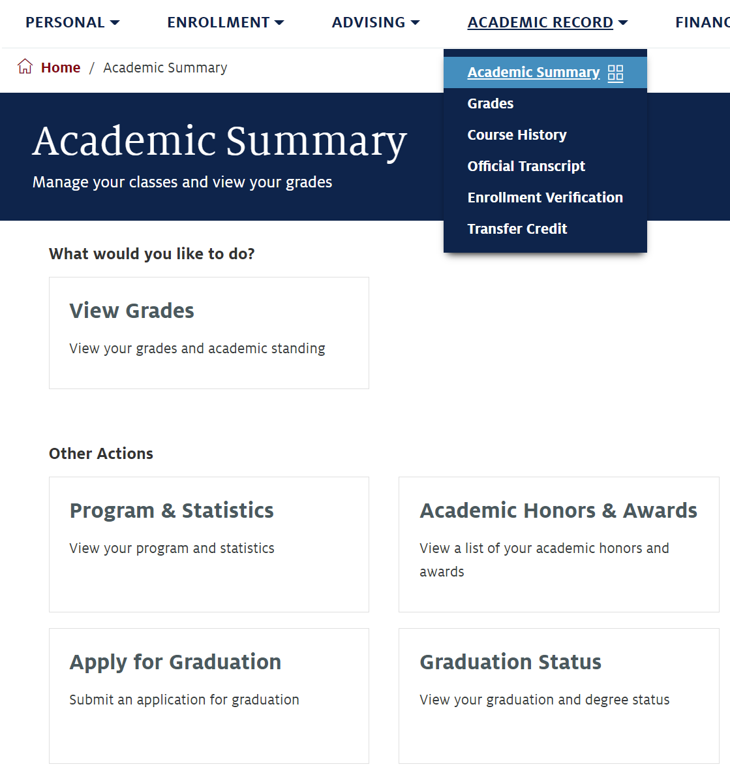
Next Steps: Receiving your U of A Diploma
It usually takes 10-14 business days for your degree to post after all required GradPath forms have been completed.
You can confirm your degree has been posted in the Academic Summary section of your Student Center (studentcenter.arizona.edu).
Your physical diploma will be shipped to PSUT about a month or so after your degree has been posted.
Notes:
Cindy

Slide 21
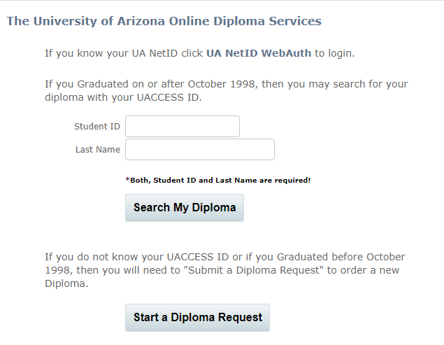
Next Steps: Receiving your U of A Diploma
If you need proof of degree completion quickly for a job opportunity or further education, you can order an eDiploma 10 days after your degree has been posted.
Your eDiploma is a signed and certified PDF of your original paper diploma used for easy diploma verification purposes. You will receive your eDiploma within 60 seconds of ordering.
There is a one-time $20 USD charge. You can then forward your eDiploma as often as you need.
For document security, the eDiploma cannot be printed.
Link to order eDiploma AND to check status of Diploma: https://www.michaelsutter.com/arizona
  UA NETID AND PASSWORD IS REQUIRED!
Notes:
Cindy

Slide 22
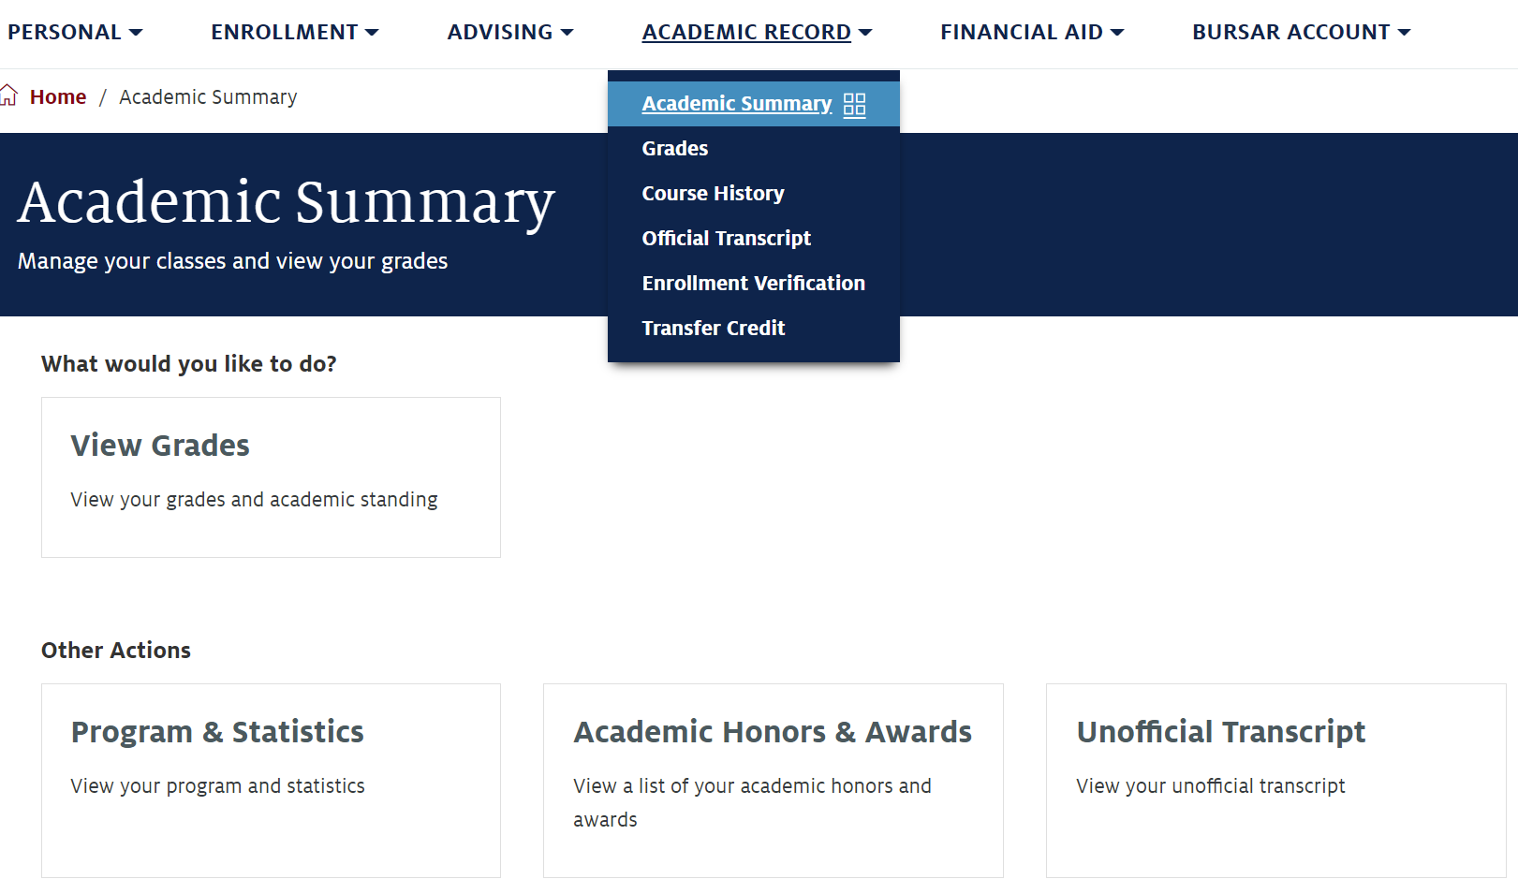
Next Steps: Ordering U of A Transcripts
You can order unofficial U of A transcripts at any time, free of charge, in your UAccess Student Center (studentcenter.arizona.edu).
Notes:
Cindy

Slide 23
Next Steps: Ordering U of A Transcripts
Eventually, you will need to authenticate your U of A degree with Amideast/Jordan, per Jordanian MOE requirements.
Transcripts must be sent directly to Amideast's Jordan office by the school or university. Only the U of A Registrar's Office can send the transcripts. Neither SIE nor Arizona International can send transcripts.
For more information and authentication instructions, please view the Amideast/Jordan website here: https://www.amideast.org/jordan/study-in-the-usa/advising-and-other-services/authentication-certification
Notes:
Cindy

Slide 24
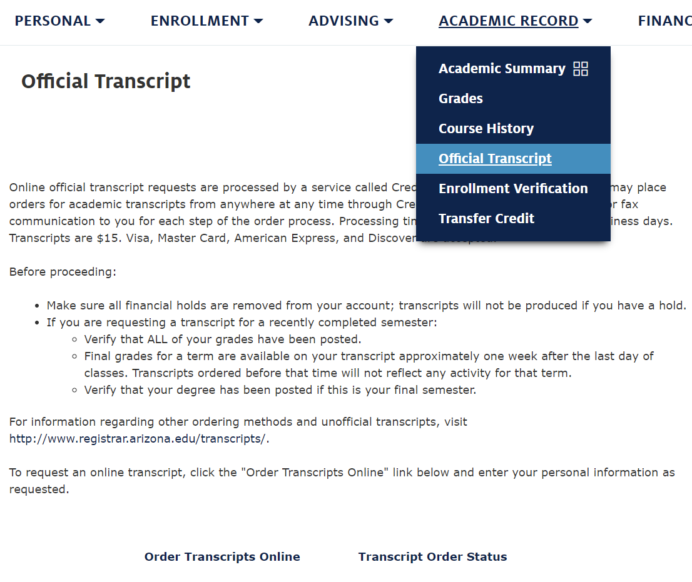
Next Steps: Ordering U of A Transcripts
You can also order official U of A transcripts in your UAccess Student Center (studentcenter.arizona.edu).
You can order physical or digital copies. Price depends on your format and shipping choice, but you must use a credit card for payment.
WE HIGHLY RECOMMEND selecting International Federal Express shipping so you can receive a tracking number and monitor the shipping history as your package travels to you internationally.
Transcripts have gotten lost in the mail, and the Registrar’s Office is not accountable for lost mail, nor will they give you a refund.
Notes:
Cindy

Slide 25
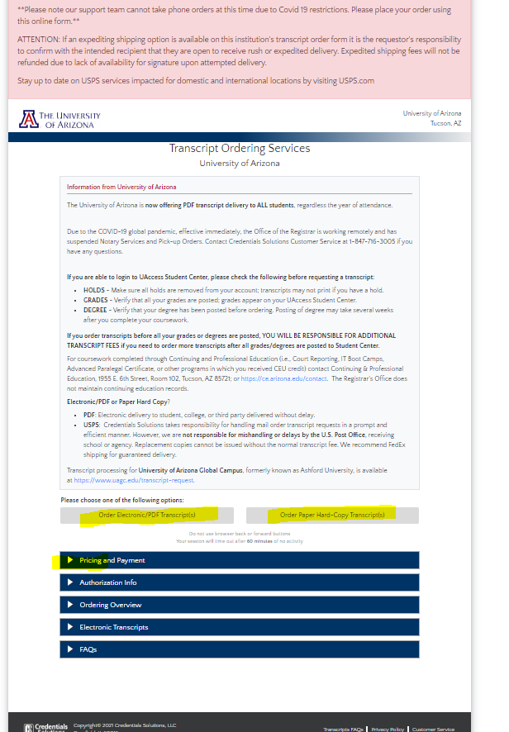
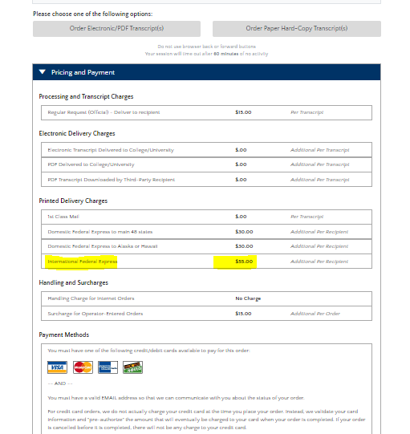
Next Steps: Ordering U of A Transcripts
You will be routed to a separate screen via Credentials Solutions.
Under "Pricing and Payment", various options of delivery are available here.
If you are also looking to deliver to a U.S location, federal express domestic options are also available.
Notes:
Cindy

Slide 26
Next Steps: Attending Graduation
We would love to see you all in Tucson for graduation!
Details regarding the ceremony will be sent to you as soon as we are officially notified of what events will be occurring and when they will occur.
Generally, Fall graduates will have a ceremony in December hosted by the College of Engineering, and Spring graduates will have a ceremony in May hosted by the SIE Department.
Notes:
Cindy

Slide 27
Next Steps: Attending Graduation
Arizona International can assist with the immigration process by providing an official letter of invitation that you can submit with your visa application (you will most likely need a B2 tourist visa – this program does not qualify you for an F1 student visa!).
You will be sent a survey to request this letter soon if you have not already received it.
This letter of invitation is the only assistance U of A can provide with your trip to Tucson. You will be fully responsible for planning and paying for your travels to Tucson, like any other vacation you might take.
Notes:
Cindy

Slide 28
Contact Us!
Department of Systems and Industrial Engineering:
gradadvisor@sie.arizona.edu
Arizona International Office:
microcampus@arizona.edu
Graduate College Degree Counselor:
kdavenport@arizona.edu

