Slide 1
Princess Sumaya University for Technology & University of Arizona SIE
Dual Degree: Masters of Engineering Management

Slide 2

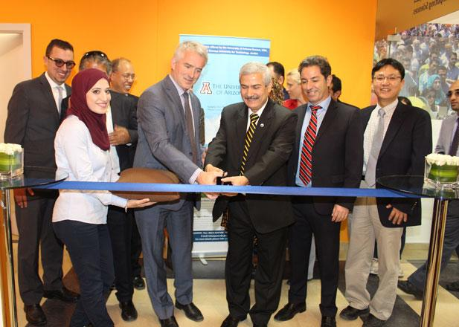
College of Engineering & SIE
The College of Engineering is the individual college of engineering studies at the University of Arizona.
The Engineering Management MS is housed within the Department of SIE.
The University of Arizona Systems & Industrial Engineering was established in 1961, the first in the nation!
The MS in Engineering Management is designed for graduate engineers and scientists aspiring to advance into management careers within technological organizations.

Slide 3
Graduate Non-Degree vs. Degree Seeking
Graduate Non-Degree Seeking (GND)
Non-Degree students are eligible to enroll in graduate-level courses
  In SIE, we provide the opportunity for students to take graduate level courses to 're-establish' their GPA
  As GND students, students can take up to four classes (12 units). The department will review progress to determine progression to degree seeking. The 12 units can count towards the MS degree!
  After successful completion, apply to the degree seeking program = BE REVIEWED for full degree seeking admission
Graduate Degree Seeking (DS)
Maintain minimum 3.00 cumulative GPA
Transfer Courses from PSUT must be B grades or higher
Notes:
If students start NDS, they will have to submit a DS application in the future through GradApp. They must submit all required materials (transcripts, diploma, LORs, resume, personal statement, English Proficiency, etc.) and be accepted as DS by the Graduate College.

Slide 4
Engineering Management (MS) – 33 units total
18 units will be from UArizona
UA Course Code | UA Course Name | Unit Totals
SIE 514 | Law for Engineers and Scientists | 3
SIE 515 | Technical Sales & Marketing | 3
SIE 522 | Engineering Decision Making Under Uncertainty | 3
SIE 557 | Project Management | 3
SIE 567 | Financial Modeling for Innovation | 3
SIE 565 | Supply Chain Management | 3
Notes:
The course requirements we sharing are to earn the UA degree ONLY. PSUT may have different graduation requirements to earn their degree.

Slide 5
Engineering Management (MS) – 33 units total
15 units will be from PSUT
PSUT Course Number | PSUT Course Name | Unit Totals
26723 | Mathematical Decision Making | 3
26790 | Advanced Topics in Engineering Management | 3
Elective Courses (take 3 of these courses)
13742 | Enterprise Systems Architecture | 3
13746 | Testing/Quality Management | 3
33758 | People Leadership/Human Resource Management | 3
13743 | Cloud Computing & Big Data | 3
33773 | Management of Innovation | 3
33772 | New Product Development | 3
33762 | Strategic Management of Entrepreneurial Organization | 3
Notes:
Note that only 3 electives from PSUT are required to earn the UA degree. PSUT may require you to take more than 3 of the electives listed here.

Slide 6
Graduation Flow Chart
Graduation Requirements
1. Finish your UArizona + PSUT courses
2. PSUT official transcripts sent to UArizona
3. GradPath > FIRST - Submit your Transfer Credit Evaluation form listing PSUT courses
4. GradPath > Completing remaining GradPath forms and SIE MS Exit Survey
5. Graduate!
  Maintain minimum 3.00 Cumulative GPA
  Complete GradPath forms and other department requirements
Notes:
If you do not meet all the requirements for graduation, you will not have your degree awarded and you will not earn your UA diploma until you have completed everything necessary. No exceptions!!

Slide 7
Frequently Asked Questions
  I need to take a semester (up to a year) off from school for personal/medical purposes. What do I do? Contact PSUT advisor, SIE advisor and AZ International support to discuss. A Leave of Absence Petition might be required to keep your position in the University of Arizona. See full policy details here: https://grad.arizona.edu/policies/enrollment-policies/leave-absence
  Can I complete my remaining program requirements in Tucson? Yes, in your last year in the program. At least one full academic semester, up to two semesters. Student must be able to pay non-resident tuition. Consult with PSUT advisor first.
  Who enrolls me into UA classes? AZ International Office enrolls you into your classes. You do not need to enroll yourself. If you need to un-enroll from a class, please inform your PSUT and SIE advisor. You should not un-enroll yourself.
  I can't see my courses in D2L? If your classes begin in less than one week, contact the AZ International Office.

Slide 8
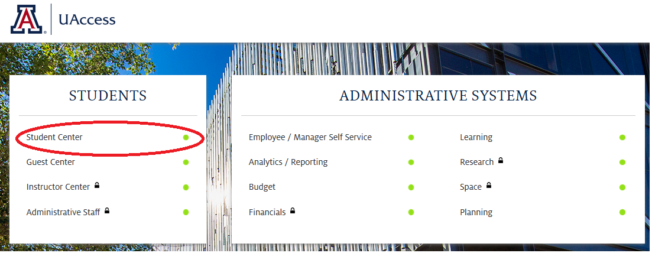
How do I navigate UAccess?
Link: uaccess.arizona.edu
Click on ‘Student Center’
Log in with your UArizona NetID and Password
  NOT your 8-digit student ID number

Slide 9
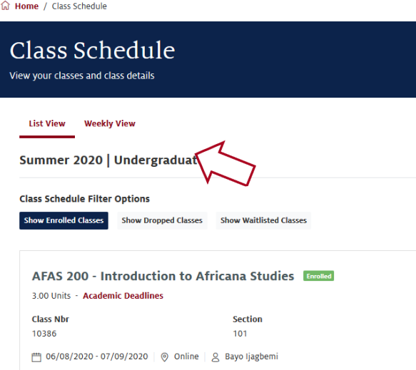
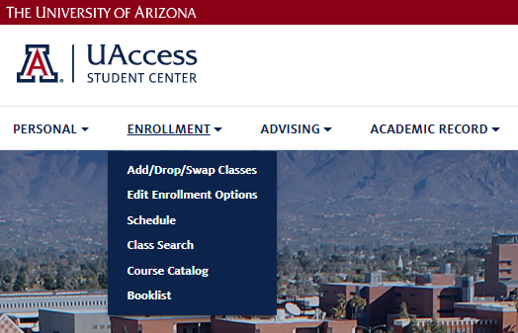
How do I navigate UAccess?

Slide 10
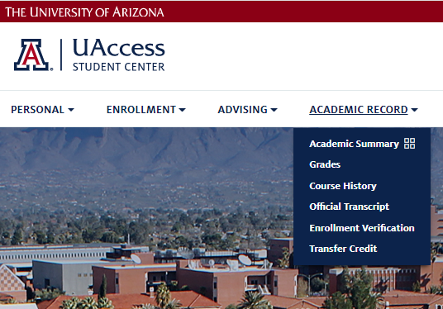
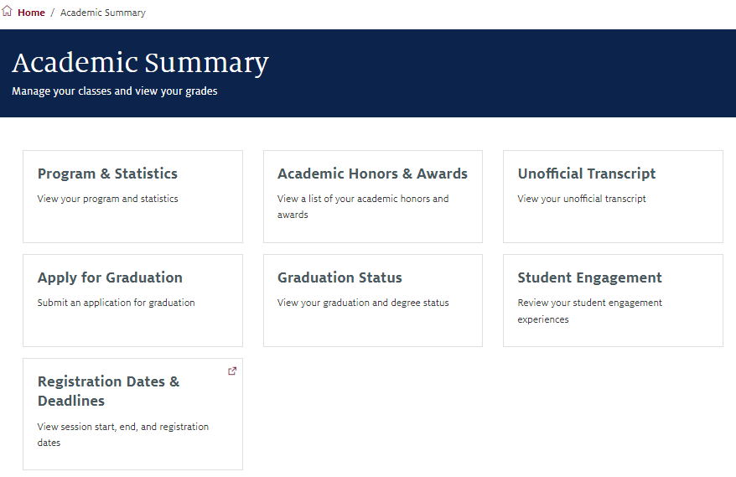
How do I navigate UAccess?

Slide 11
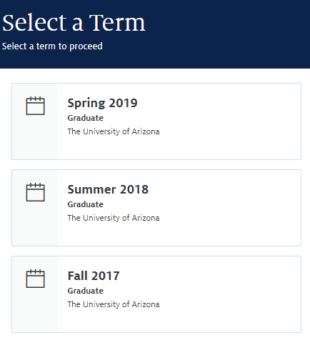
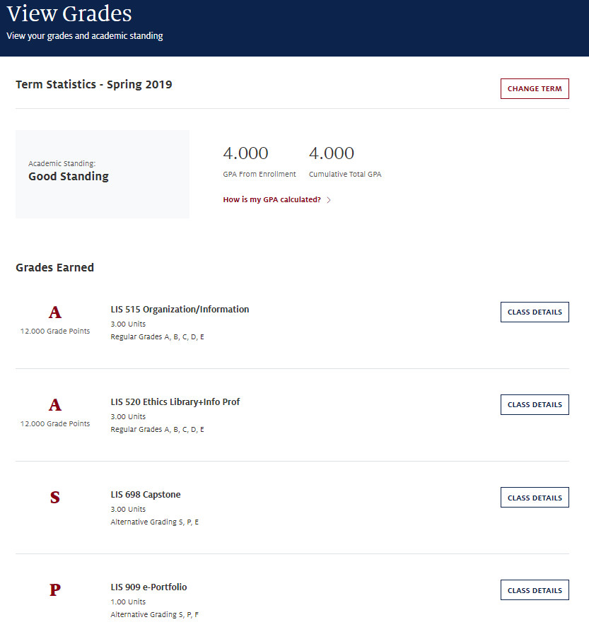
How do I navigate UAccess?

Slide 12
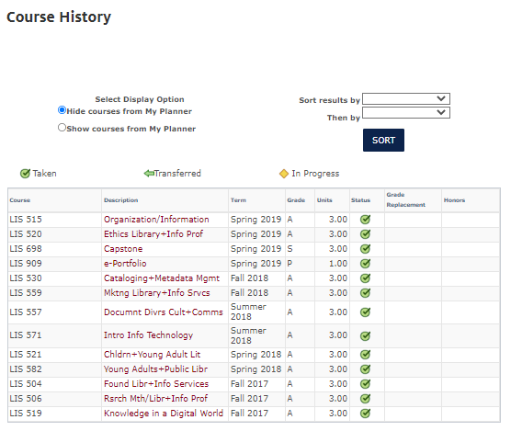
How do I navigate UAccess?

Slide 13
Helpful Resources
UAccess Tutorials: https://it.arizona.edu/documentation/student-center-how-tos
D2L Tutorials: https://help.d2l.arizona.edu/index.php/content/instructional-tutorials-0
D2L Help Site: https://help.d2l.arizona.edu/index.php/content/getting-started
UArizona Office of the Registrar’s:
  Transcripts: https://www.registrar.arizona.edu/transcripts
  Important Dates & Deadlines: https://registrar.arizona.edu/dates-and-deadlines
Career Services: https://career.arizona.edu/
Technology Support (24/7 IT Support Center): https://it.arizona.edu/get-support

Slide 14
Tips for Success
Manage Time Effectively (time for school, time for family, time for self)
Get to Know the Faculty
Communicate with Both Universities
Ask for Help Before You Need It
Keep Eye on Career Goals

Slide 15
Contact Us!
Department of Systems and Industrial Engineering:
gradadvisor@sie.arizona.edu
Arizona International Office:
microcampus@arizona.edu

